Slide 1

Effort Reporting – Navigating the System as a Pre-Reviewer
A guide to the Drexel self-service banner Effort reporting system

Slide 2
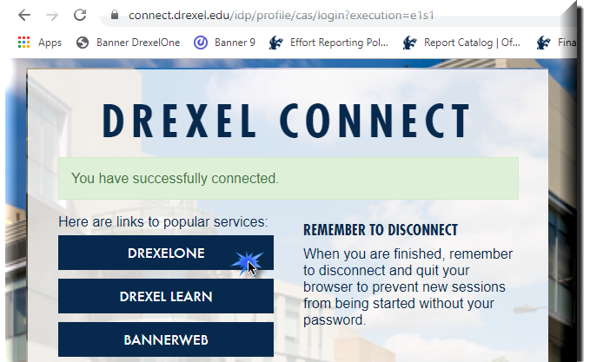
Log in to Self- Service Banner

Slide 3

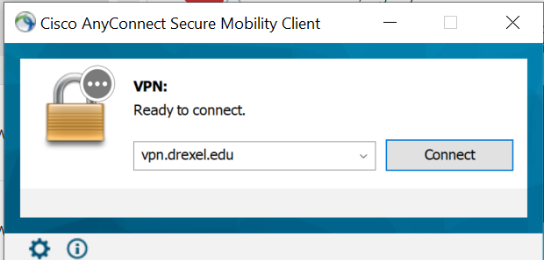
Important Update for Signing Into Effort Reporting system:
Beginning September 2020, DrexelVPN is required in order to access Effort Reporting and Labor Redistribution System. If you are trying to use Labor Redistribution/Effort Reporting from off-campus, you must log on to the Cisco AnyConnect VPN application to ensure a secure connection to the Drexel Network.
Installation Instructions for the Cisco AnyConnect VPN client can be found here: https://drexel.edu/it/help/a-z/VPN/ .

Slide 4
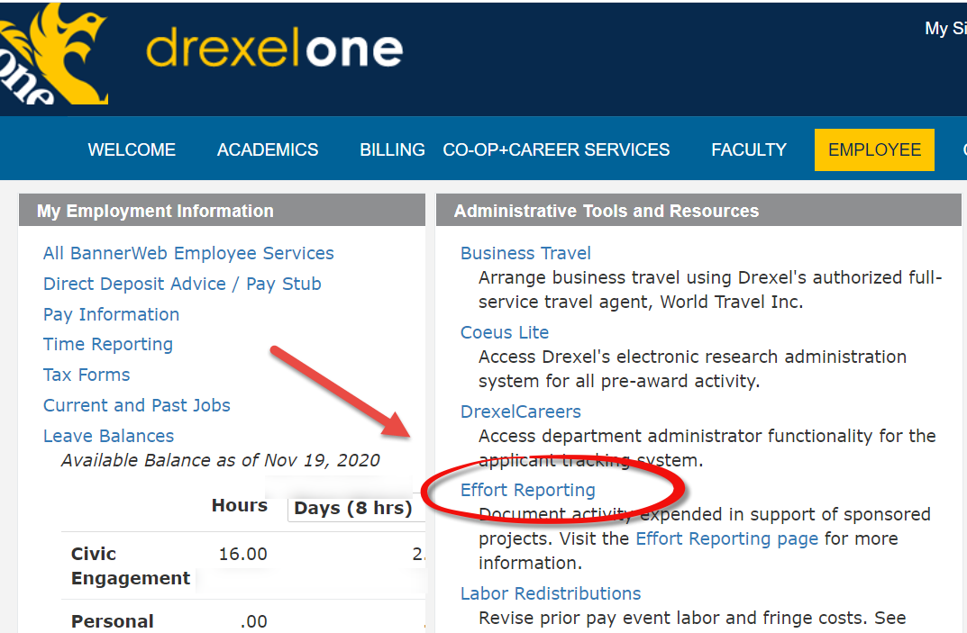
Select “Effort Reporting” link under Administrative Tools and Resources section of the Employee Main Menu tab

Slide 5
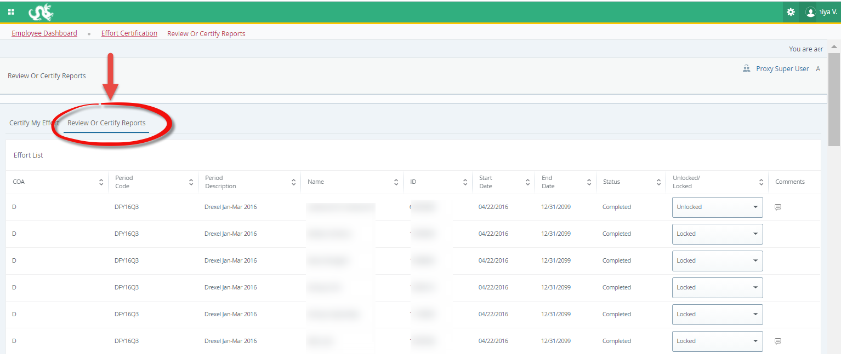
Select “Review or Certify Reports” tab

Slide 6
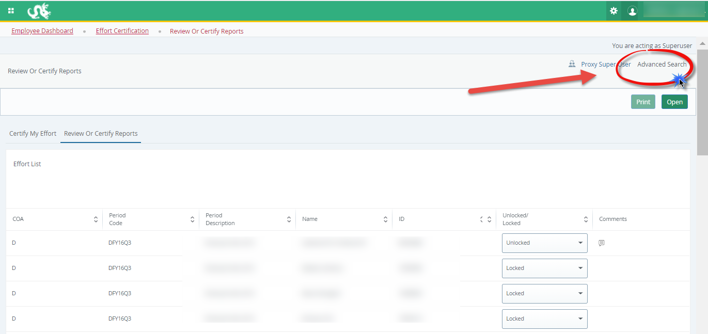
Open “Advanced Search” menu

Slide 7
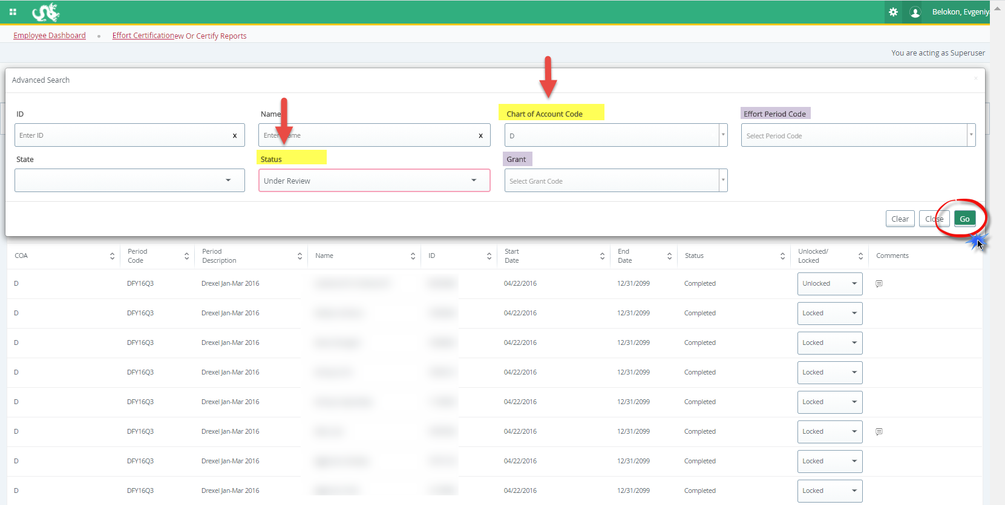
Select “Chart of Account Code”- D or S, and “Status” Under Review from the menu (you may filter further on grant/ID/name or effort period), click “Go”

Slide 8
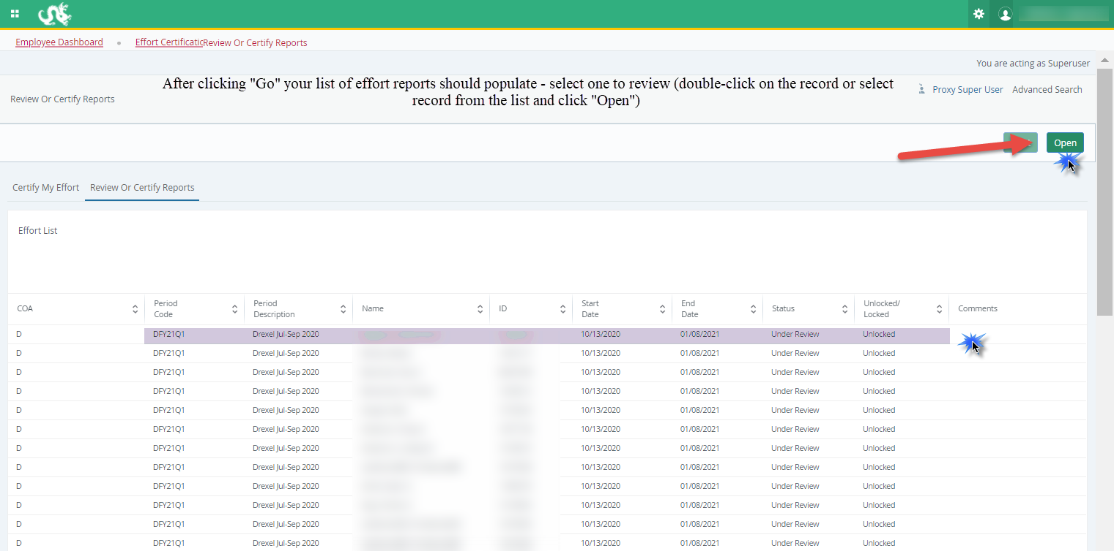

Slide 9
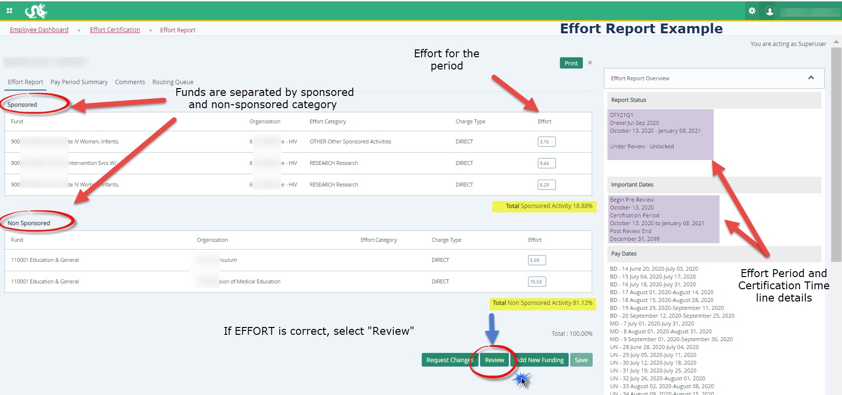
Certifier:
Certify Effort
Example Effort Report:
Click ‘Certify’ if effort is CORRECT

Slide 10
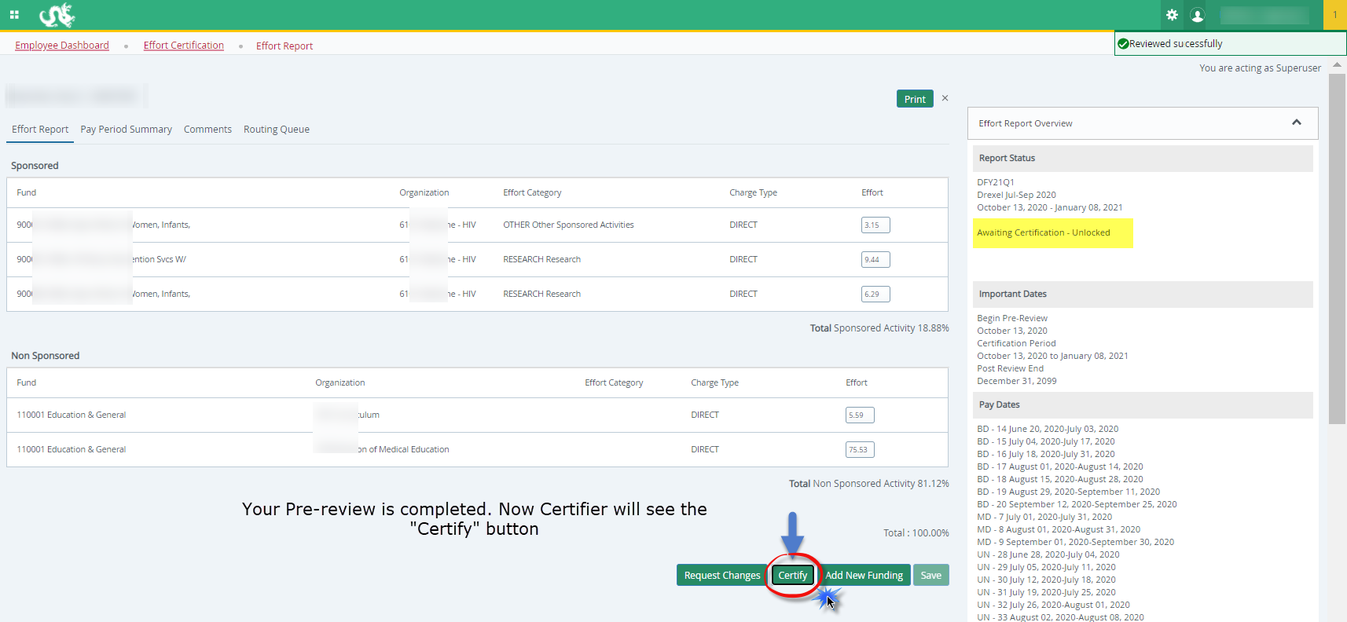

Slide 11
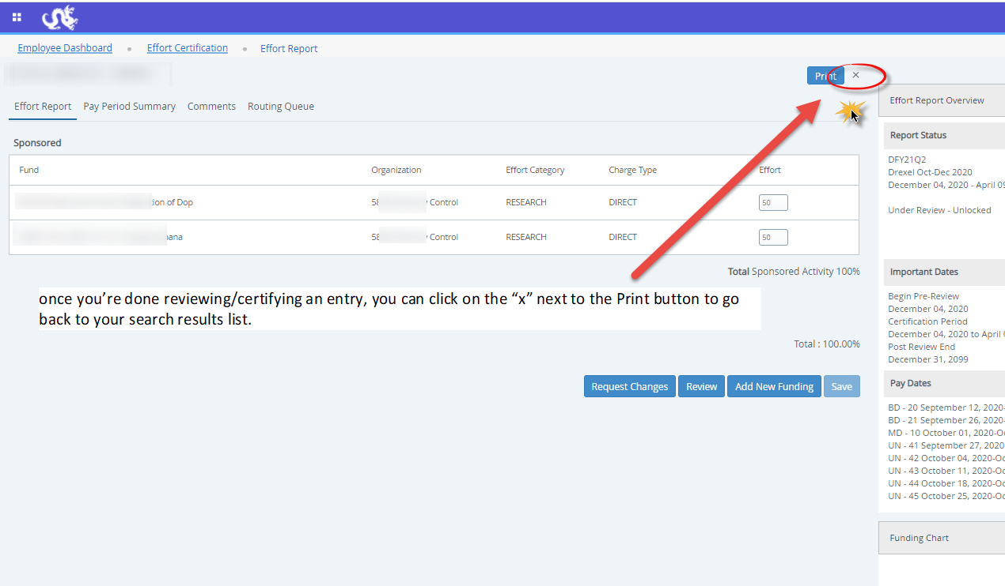

Slide 12
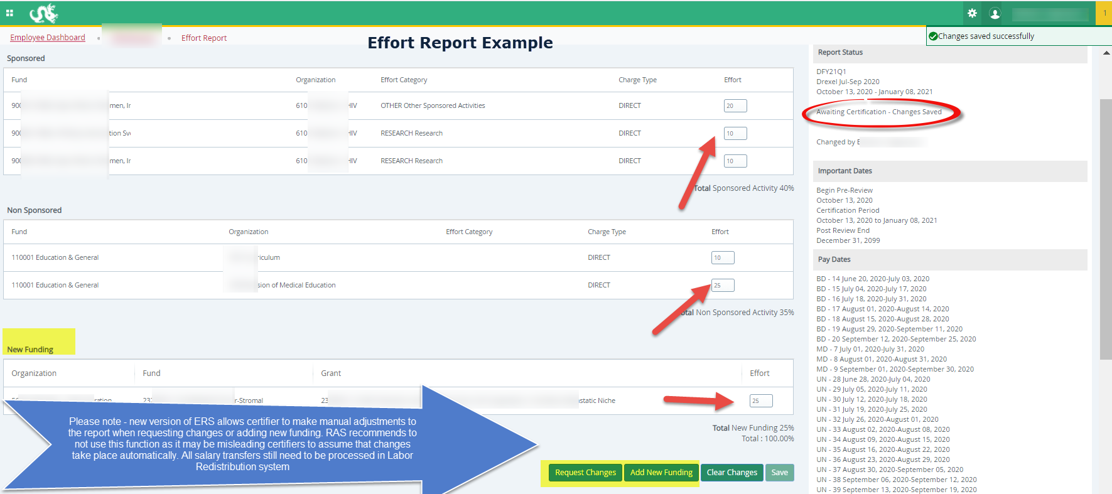

Slide 13
Pre-Reviewer: Incorrect Effort Report
If the Effort Report is not correct, do NOT select “Review.”
  Instead, send an email with the desired changes to the individual in your department who processes labor redistributions (in most cases, the pre-reviewer has access to process the labor redistributions themselves)
Make the change in the labor redistribution tab
  Change to effort will not be automatic
  Labor redistribution needs to get all of its necessary approvals
  Once it reaches disposition code of 70, labor redistribution is complete and processed in the labor redistribution system, RAS will create new effort report in Banner ERS
  Contact RAS for issues/questions

Slide 14
Pre-Reviewer: Mistake
If pre-reviewer mistakenly hits “Review”
  Contact the Certifier to choose “Request Changes”
    If the Certifier chooses “Request Changes,” the Report will be returned to the Pre-Reviewer
  Or ask RAS and RAS can return to Pre-Reviewer
    RAS@Drexel.edu

Slide 15
Effort Reporting Additional Information: Useful Tabs on the Effort Report
Pay Period Summary Tab
  To view specific payroll activity, click this tab.
Comments Tab
  Click the Comments tab to view comments or add any comments that you find necessary.
  The Comment will be saved and available to be viewed by anyone on the Routing Queue.
  Once comments are added they cannot be updated or deleted. updated or deleted.
Routing Queue Tab
  To view the progress and details of the effort certification process.
  The Routing queue shows the status of each stage of the Effort Certification process.
  The queue will update automatically after each person completes his or her task.

Slide 16
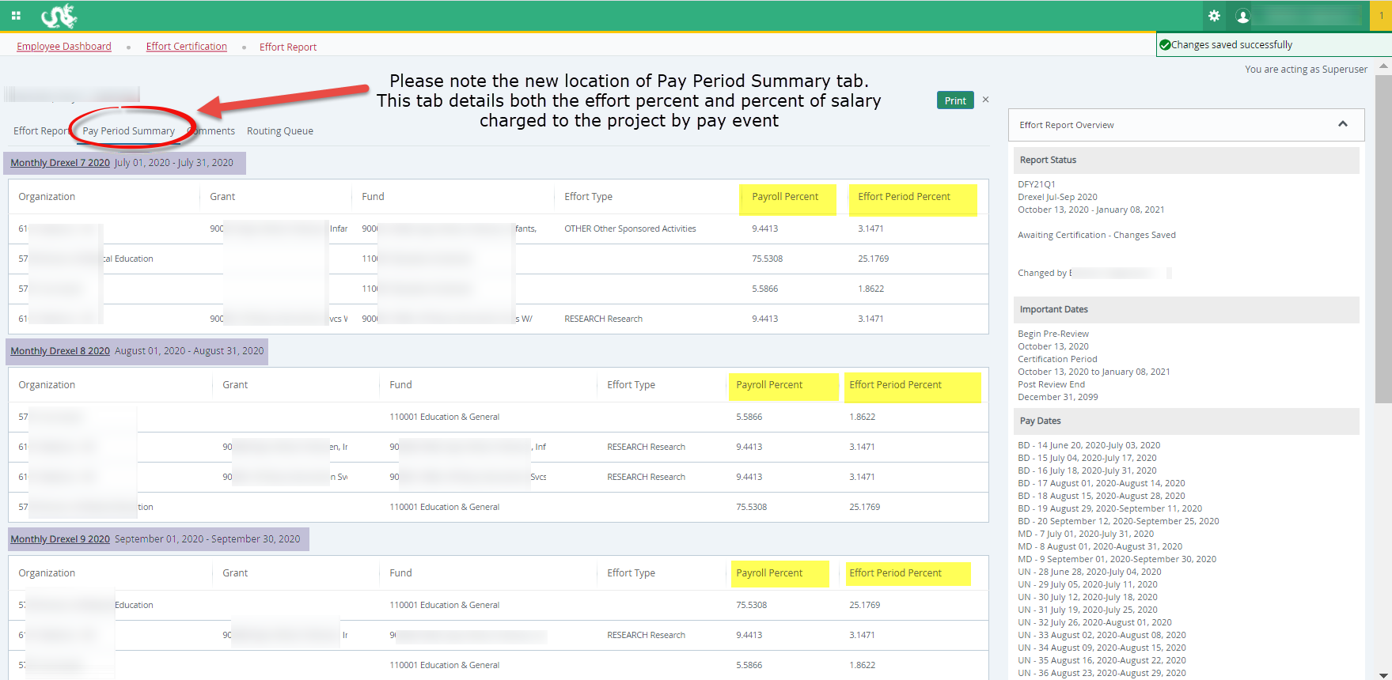
Effort Reporting Additional Information Useful Tabs on the Effort Report:
Pay Period Summary

Slide 17
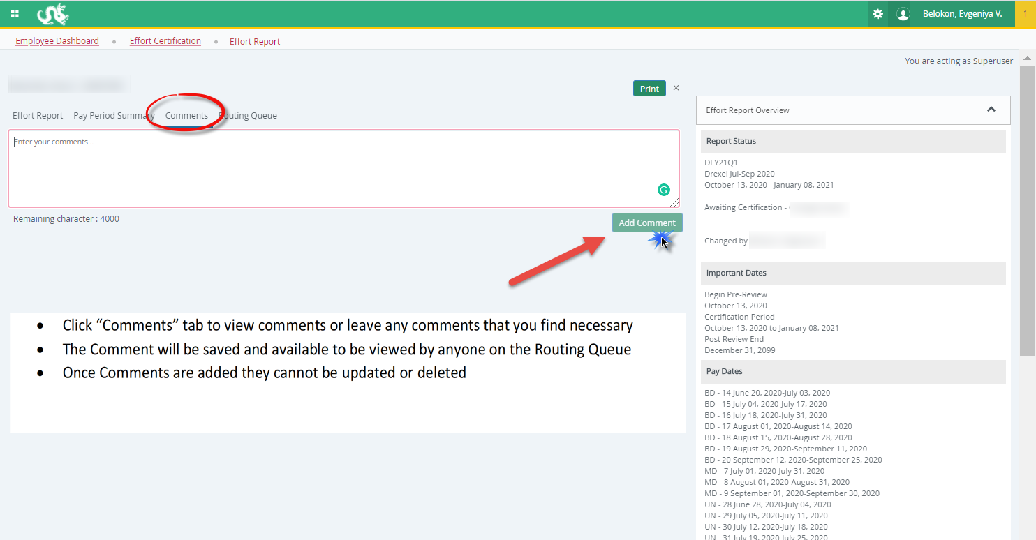
Effort Reporting Additional Information Useful Tabs on the Effort Report
Comments Tab

Slide 18
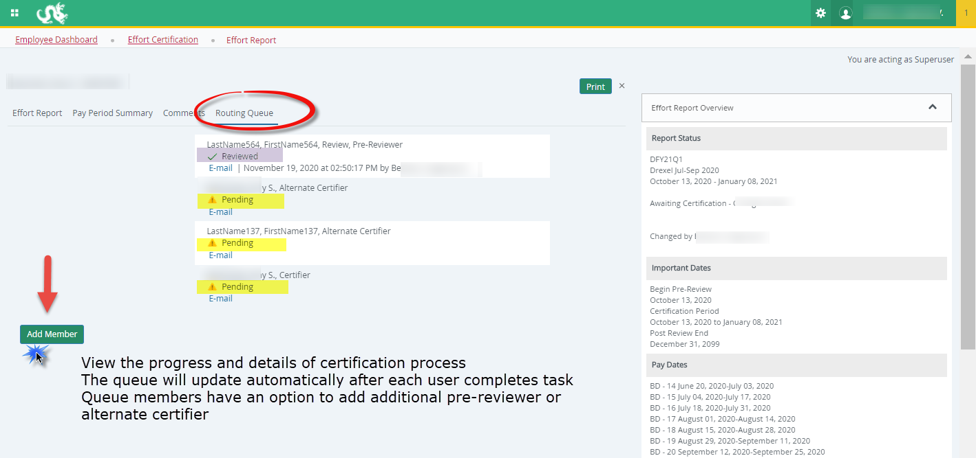
Effort Reporting Additional Information Useful Tabs on the Effort Report:
Routing Queue

Slide 19
Effort Reporting Additional Information: Types of Status/State in Pre-Reviewer’s List of Effort Reports
Status:
  Under Review: Effort report has been created and is ready to view.
  Awaiting Certification: Effort report is ready to be certified.
  Completed: Effort report has been certified and is complete.
  Awaiting Refresh: Payroll action or labor redistribution report has been completed.
State:
  Unlocked: Effort report is available for change or to be acted upon by any member in the routing queue.
  Locked: Effort report can no longer be updated.
  Changes Submitted: Changes have been made to the effort report on the effort tab.

Slide 20
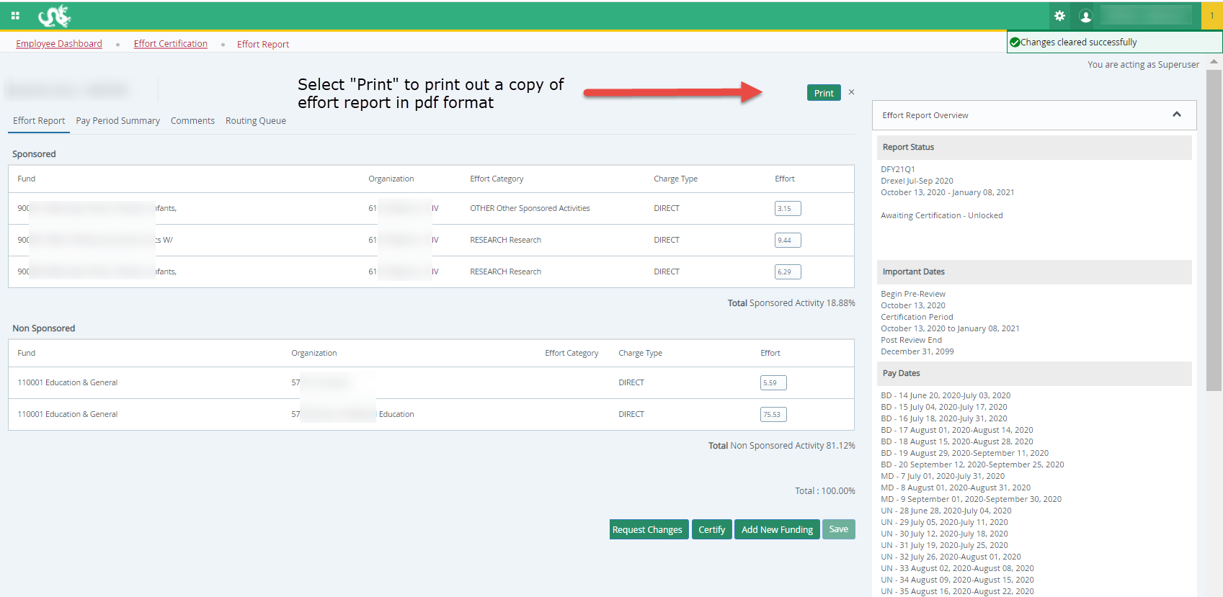
Print a Report

Slide 21
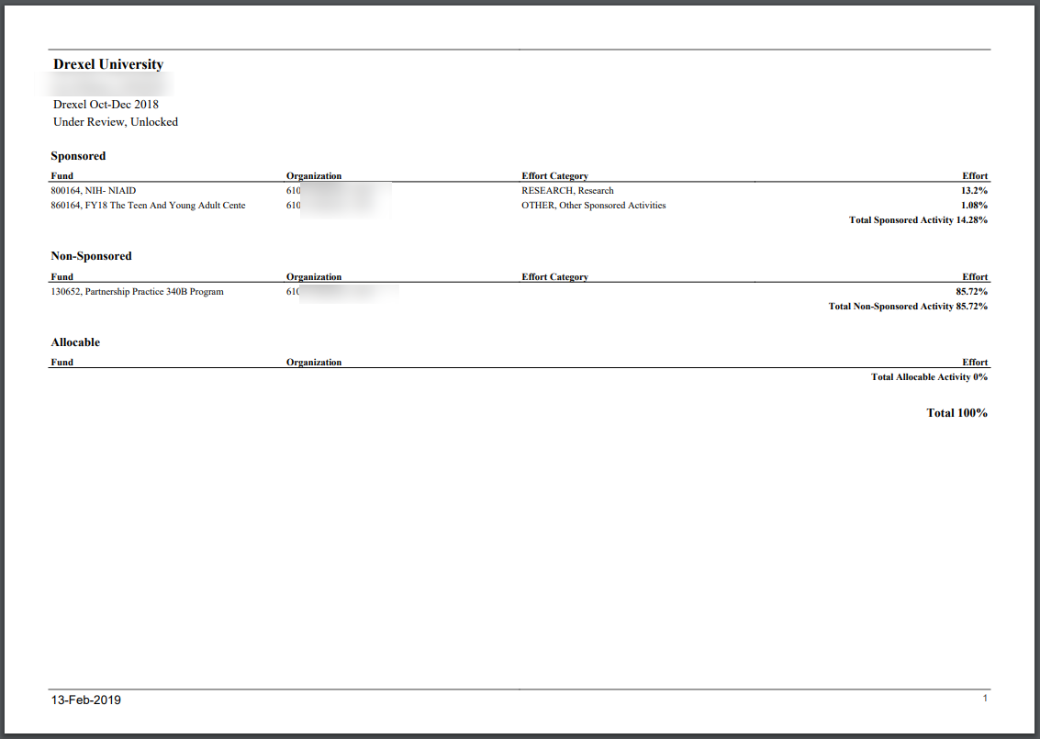

Slide 22
Locked Records
Once an effort report is in the status of Completed – Locked, all action buttons are removed, and changes cannot be done.
Once certification is complete (Locked), recertification should not occur.
In the rare event that re-certification is necessary, please contact Research Accounting Services.
  This requires further review and approval.

Slide 23
Effort Reporting Contacts
  Contacts:
  Research Accounting Services: RAS@drexel.edu
  Gabrielle Berrios
  Associate Director, Research Accounting Services
  E-mail: gc33@drexel.edu
  Phone: 215-895-1730
  Evgeniya Belokon
  Senior Financial Analyst, Research Accounting Services
  E-mail: evb29@drexel.edu
  Phone: 215-895-6327

