Slide 1

Effort Reporting – Navigating the System as an Alternate Certifier
A guide to the Drexel self-service banner effort reporting system

Slide 2
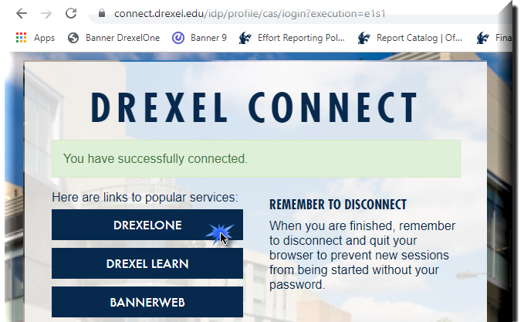
Log in to Self- Service Banner

Slide 3

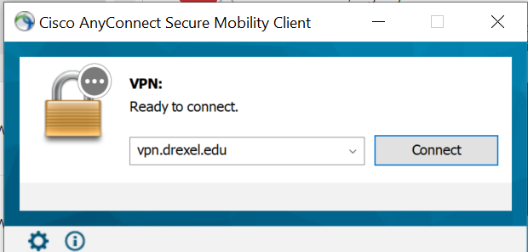
Important Update for Signing Into Effort Reporting system:
Beginning September 2020, DrexelVPN is required in order to access Effort Reporting and Labor Redistribution System. If you are trying to use Labor Redistribution/Effort Reporting from off-campus, you must log on to the Cisco AnyConnect VPN application to ensure a secure connection to the Drexel Network.
Installation Instructions for the Cisco AnyConnect VPN client can be found here: https://drexel.edu/it/help/a-z/VPN/ .

Slide 4
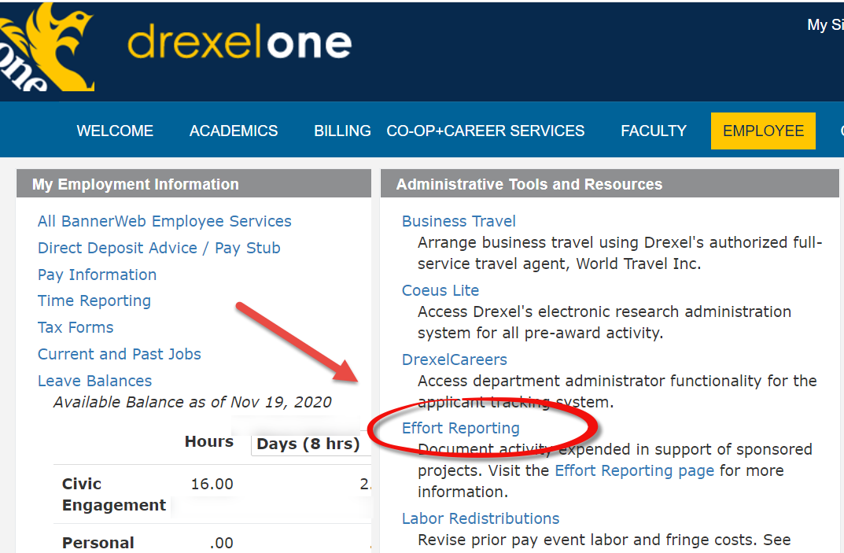
Select “Effort Reporting” link under Administrative Tools and Resources section of Employee menu

Slide 5
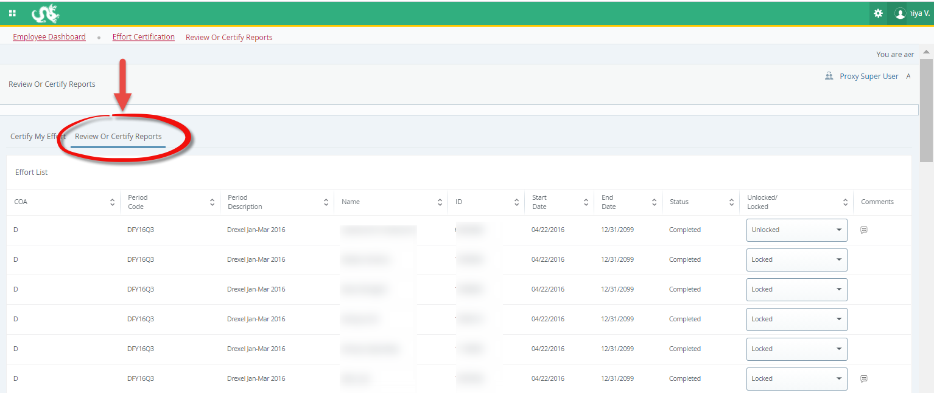
Select “Review or Certify Reports” tab

Slide 6
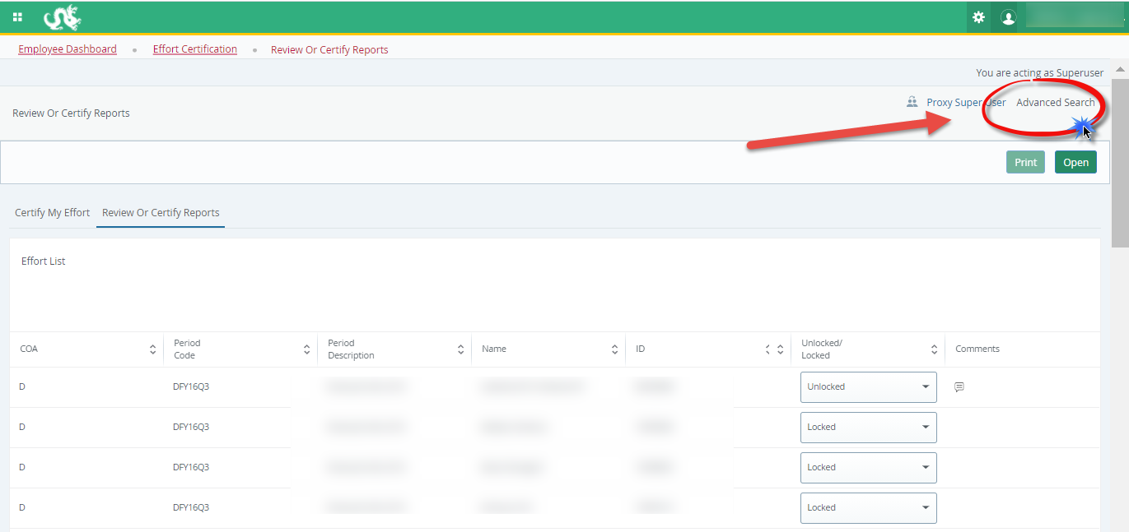
Open “Advanced Search” menu

Slide 7
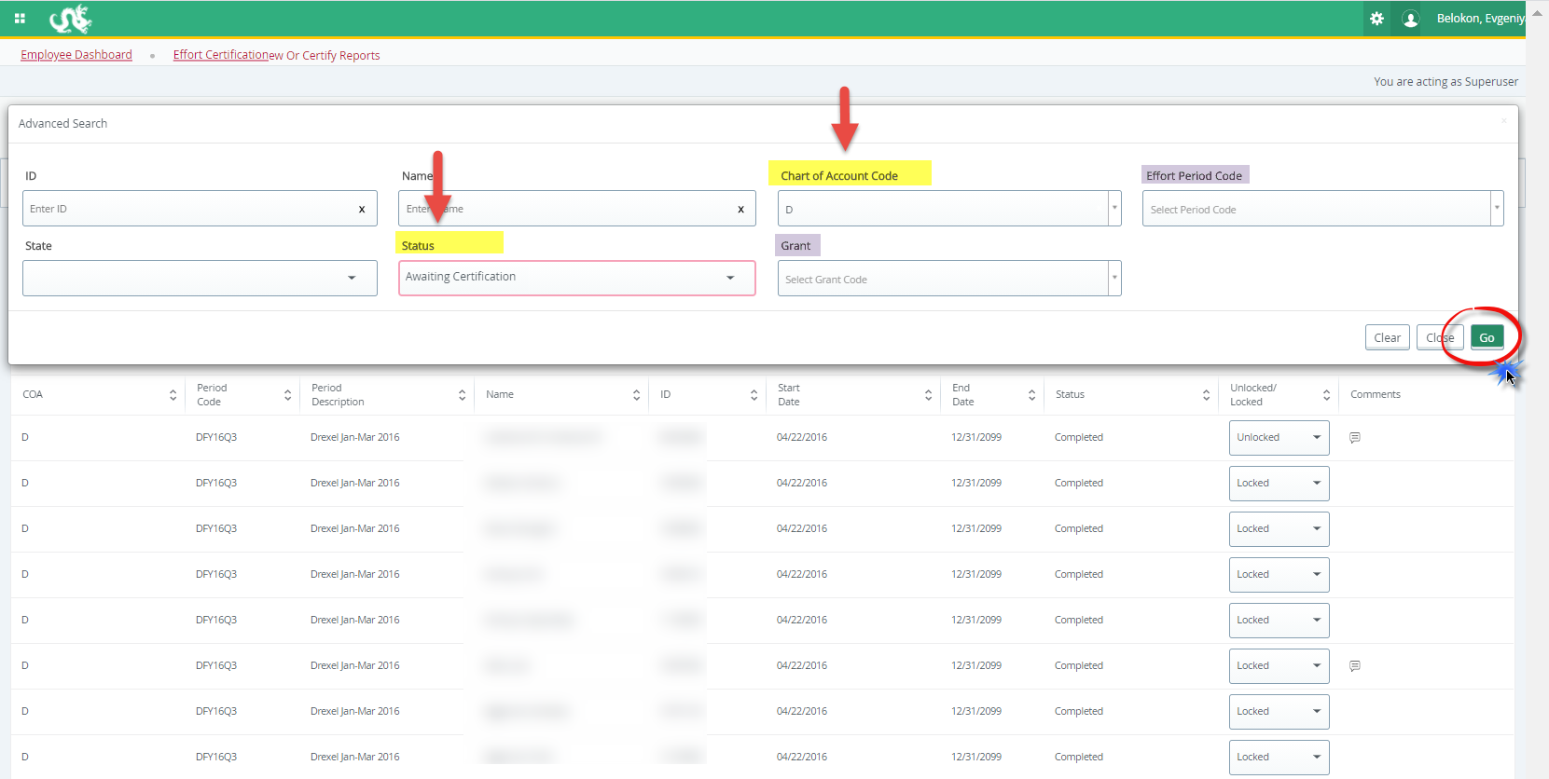
Select “Chart of Account Code” – D or S, and “Status” Awaiting Certification from the menu (you may filter further on grant/ID/name or effort period), click “Go”

Slide 8
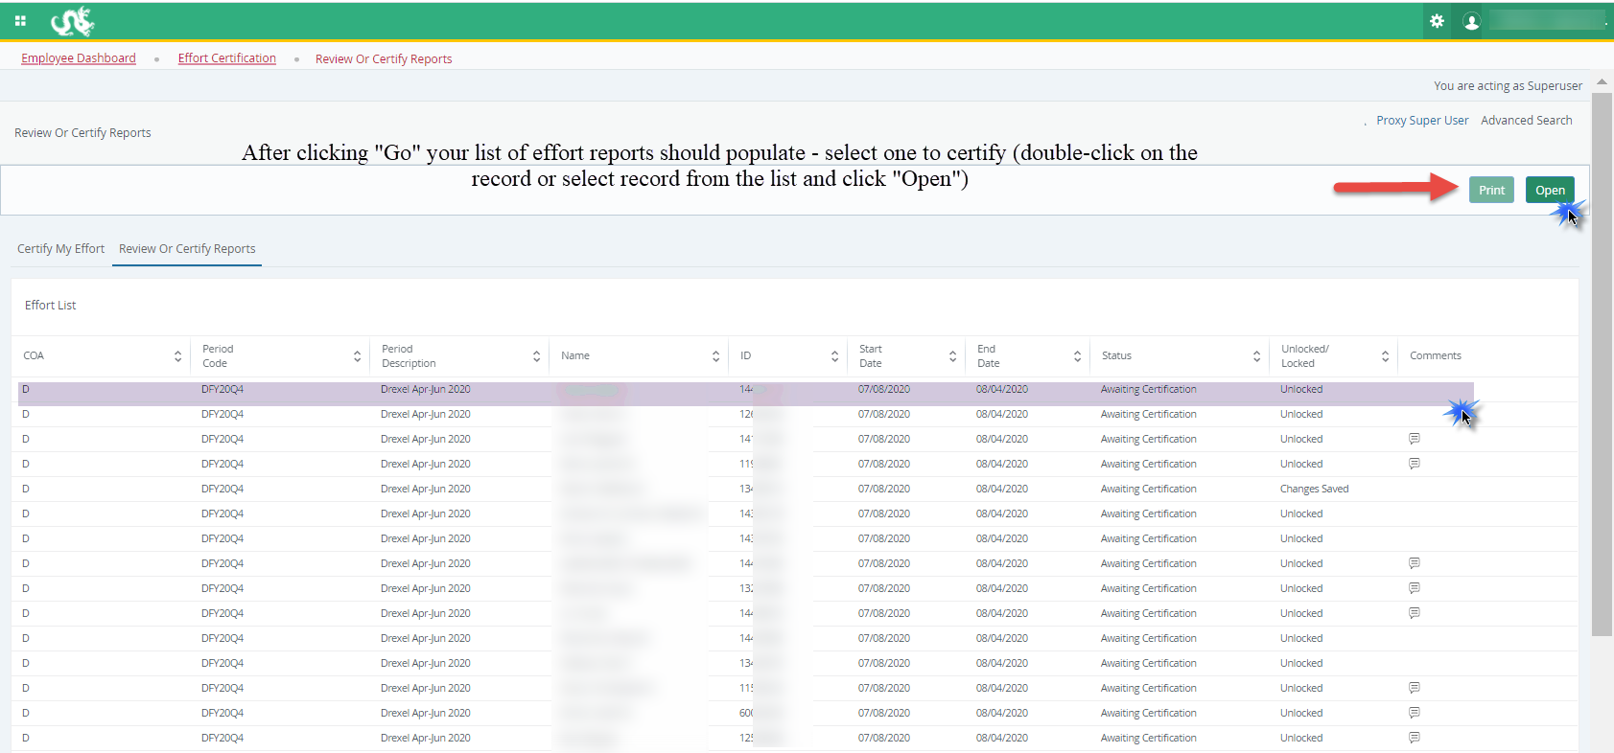
Alternate Certifier: Reports Populate

Slide 9
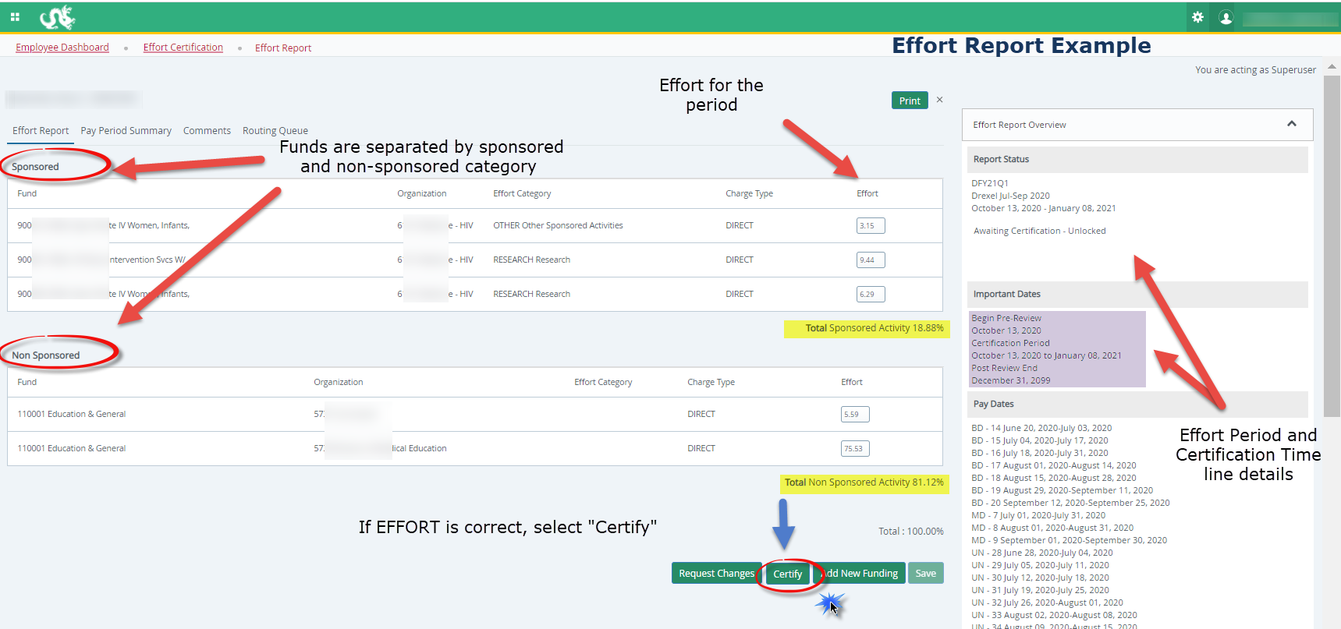
Certifier:
Certify Effort
Example Effort Report:
Click ‘Certify’ if effort is CORRECT

Slide 10
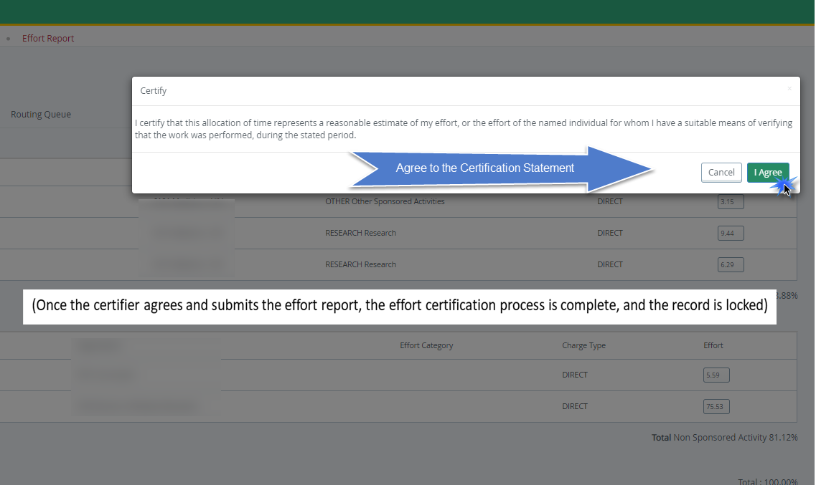
Certifier: Certify
(Once the certifier agrees and submits the effort report, the effort certification process is complete, and the record is locked)

Slide 11
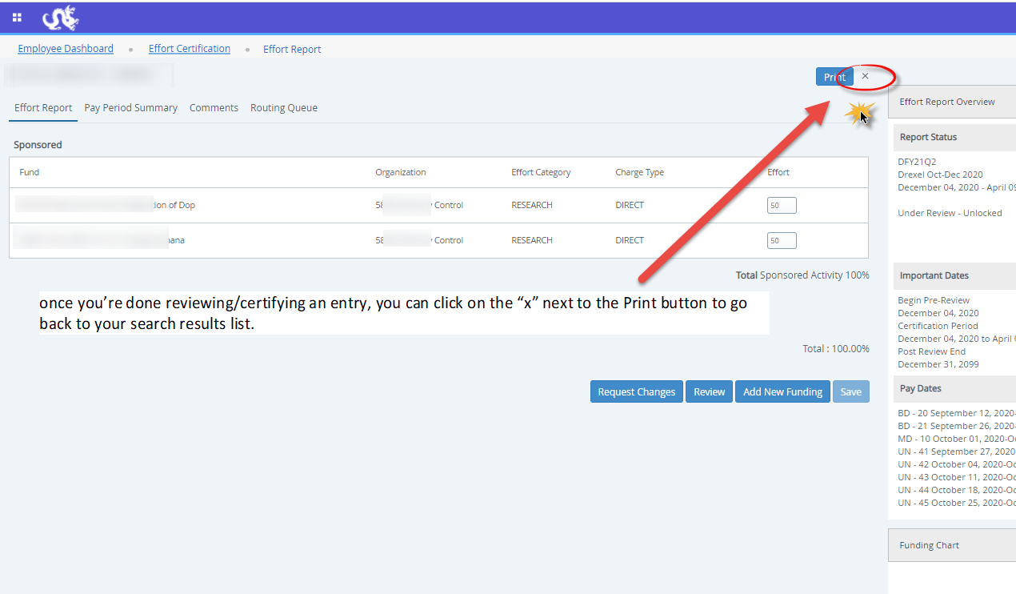

Slide 12
Alternate Certifier: Incorrect Effort Report
If the Effort Report is not correct, do NOT select “Certify.”
  Instead, send an email with the desired changes to the pre-reviewer (if you are unsure of who the pre-reviewer is for an effort report, you may check this in the ‘Routing Queue’ tab on the left side of the effort report)
The pre-reviewer will then submit the change and the effort report will be recreated to reflect your desired changes. Communicate with the pre-reviewer to find out when the change has been made so that you can go back in to certify.

Slide 13
Effort Reporting Additional Information: Types of Status/State in Pre-Reviewer’s List of Effort Reports
Status:
  Under Review: Effort report has been created and is ready to view.
  Awaiting Certification: Effort report is ready to be certified.
  Completed: Effort report has been certified and is complete.
  Awaiting Refresh: Payroll action or labor redistribution report has been completed.
State:
  Unlocked: Effort report is available for change or to be acted upon by any member in the routing queue.
  Locked: Effort report can no longer be updated.
  Changes Submitted: Changes have been made to the effort report on the effort tab.

Slide 14
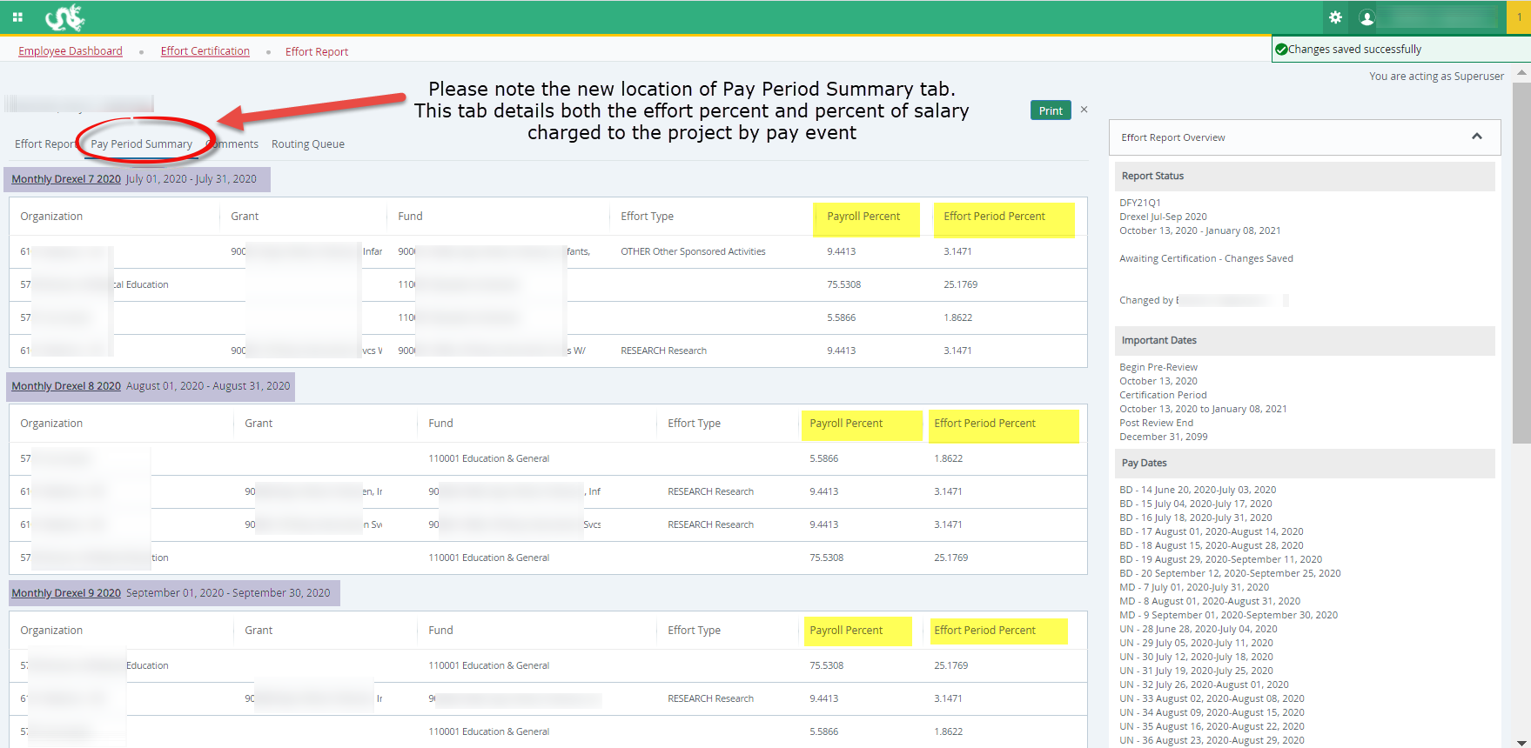
Effort Reporting Additional Information Useful Tabs on the Effort Report:
Pay Period Summary

Slide 15
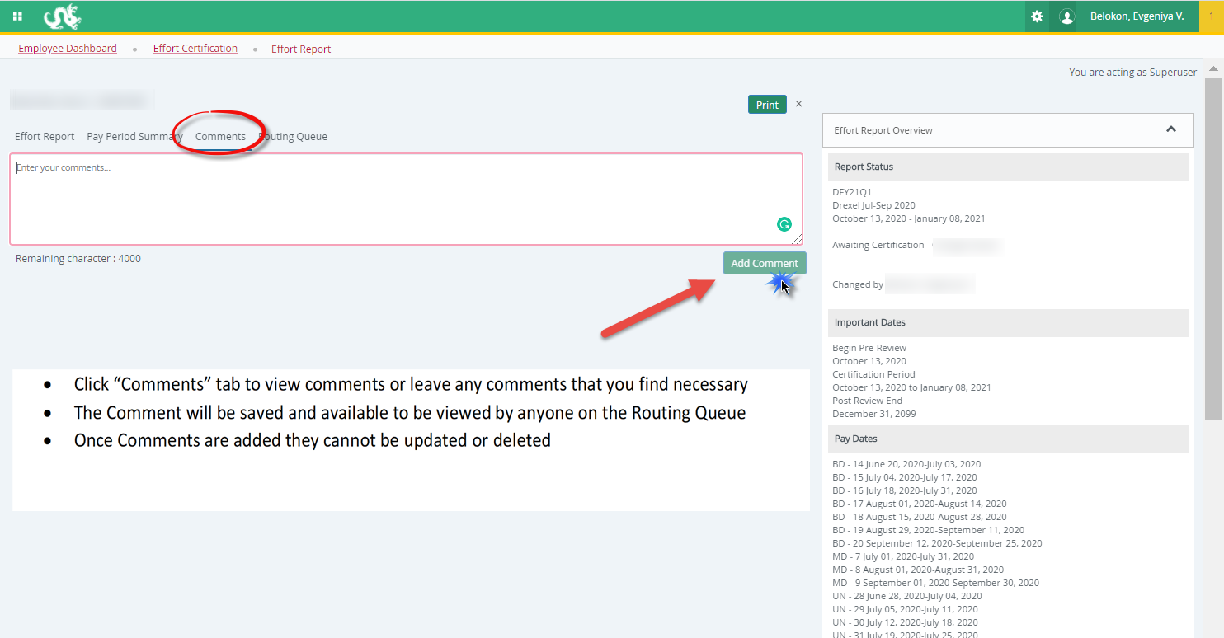
Effort Reporting Additional Information Useful Tabs on the Effort Report
Comments Tab

Slide 16
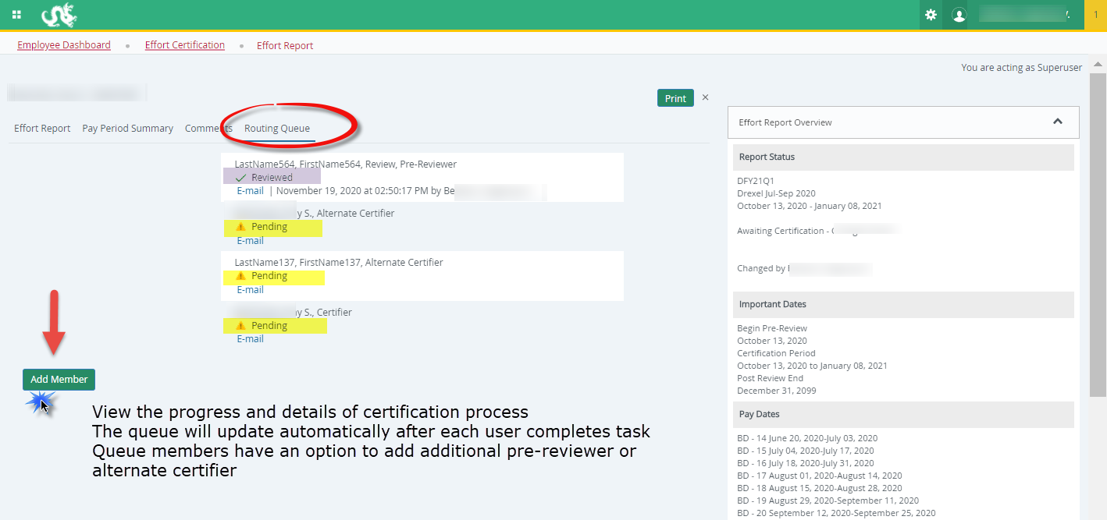
Effort Reporting Additional Information Useful Tabs on the Effort Report:
Routing Queue

Slide 17
Effort Reporting Contacts
  Contacts:
  Research Accounting Services: RAS@drexel.edu
  Gabrielle Berrios
  Associate Director, Research Accounting Services
  E-mail: gc33@drexel.edu
  Phone: 215-895-1730
  Evgeniya Belokon
  Senior Financial Analyst, Research Accounting Services
  E-mail: evb29@drexel.edu
  Phone: 215-895-6327

