Slide 1

Effort Reporting – Navigating the System as a Certifier
A guide to the Drexel self-service banner effort reporting system

Slide 2
Certifier
Receives notification that effort report is awaiting certification
Certifier checks that effort is captured accurately
If correct, hit “Certify” and agree to the certification
If Certifier does NOT agree:
  Email with the desired changes should be sent back to the pre-reviewer

Slide 3
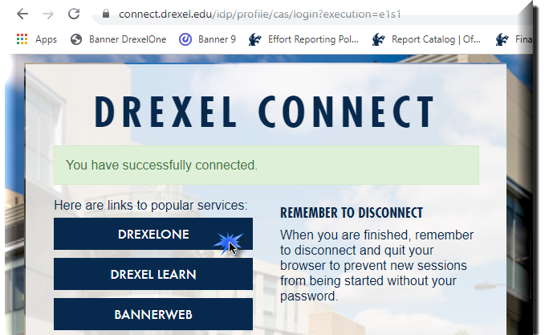
Log in to Self- Service Banner

Slide 4

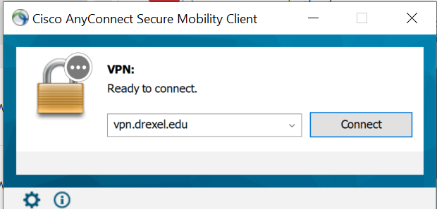
Important Update for Signing Into Effort Reporting system:
Beginning September 2020, DrexelVPN is required in order to access Effort Reporting and Labor Redistribution System. If you are trying to use Labor Redistribution/Effort Reporting from off-campus, you must log on to the Cisco AnyConnect VPN application to ensure a secure connection to the Drexel Network.
Installation Instructions for the Cisco AnyConnect VPN client can be found here: https://drexel.edu/it/help/a-z/VPN/ .

Slide 5
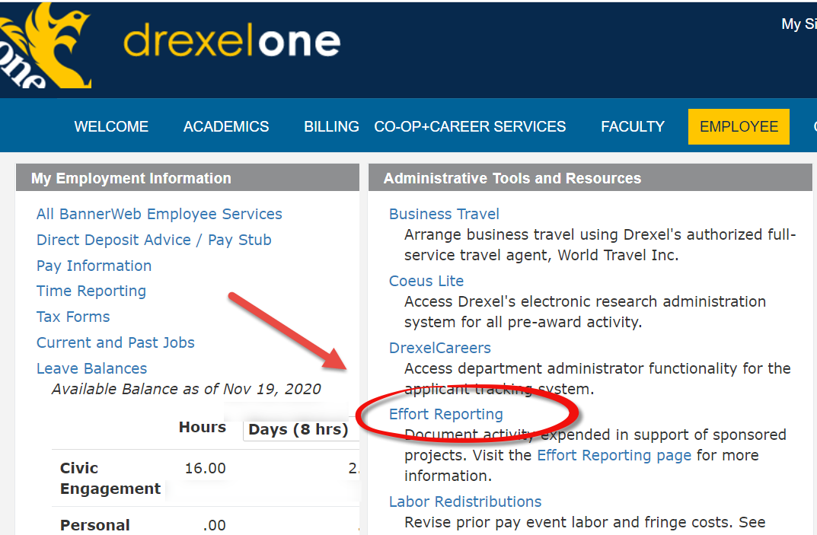
Select “Effort Reporting” link under Administrative Tools and Resources section of Employee menu

Slide 6
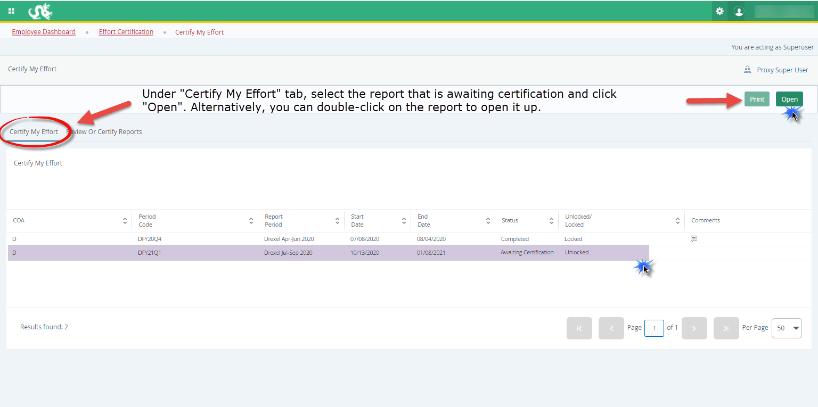

Slide 7
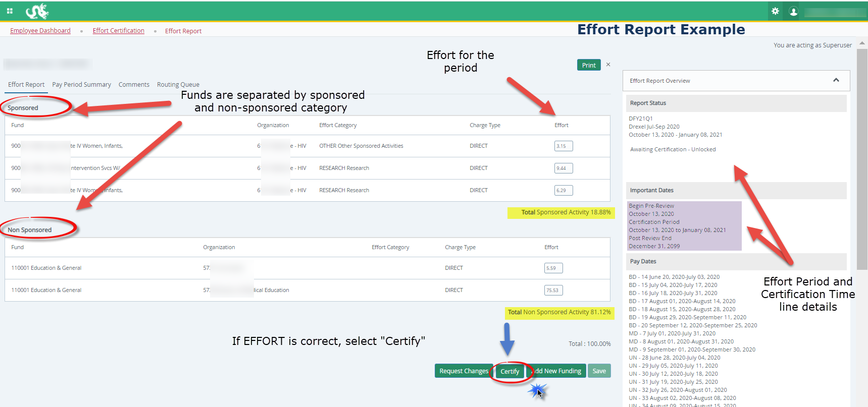
Certifier:
Certify Effort
Example Effort Report:
Click ‘Certify’ if effort is CORRECT

Slide 8
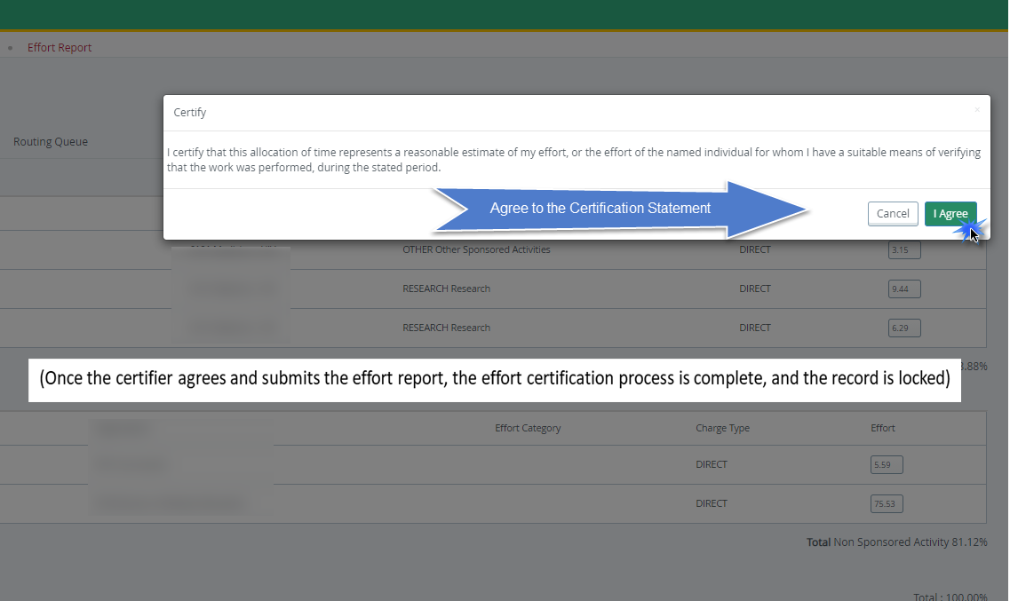
Certifier: Certify
(Once the certifier agrees and submits the effort report, the effort certification process is complete, and the record is locked)

Slide 9
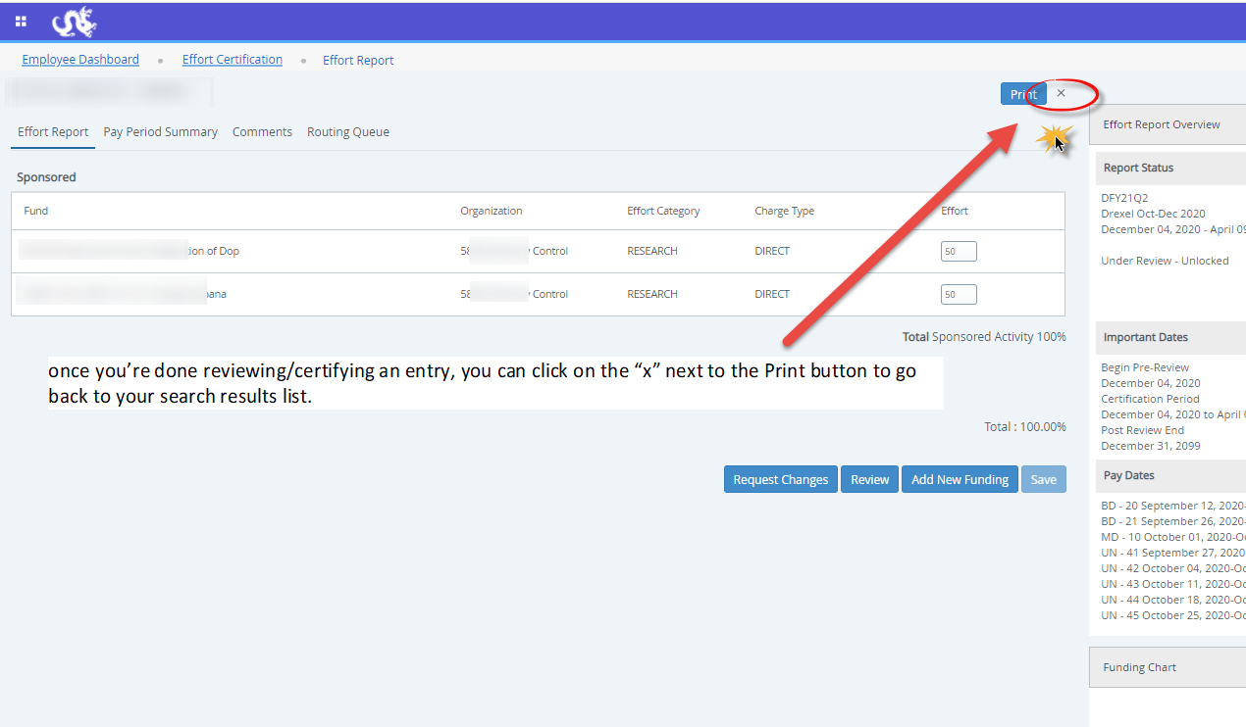

Slide 10
Certifier: Incorrect Effort Report
If the Effort Report is not correct, do NOT select “Certify”
  Instead, send an email with the desired changes to the individual in your department who processes labor redistributions (in most cases, pre-reviewer has access to process the labor redistributions)
Make the change in the labor redistribution tab
  Change to effort will not be automatic
  Labor redistribution needs to get all its necessary approvals
  Once it reaches disposition code of 70, labor redistribution is complete and processed in the labor redistribution system, RAS will create new effort report in Banner ERS
  Contact RAS for issues/questions

Slide 11
Effort Reporting Additional Information: Types of Status/State in Pre-Reviewer’s List of Effort Reports
Status:
  Under Review: Effort report has been created and is ready to view.
  Awaiting Certification: Effort report is ready to be certified.
  Completed: Effort report has been certified and is complete.
  Awaiting Refresh: Payroll action or labor redistribution report has been completed.
State:
  Unlocked: Effort report is available for change or to be acted upon by any member in the routing queue.
  Locked: Effort report can no longer be updated.
  Changes Submitted: Changes have been made to the effort report on the effort tab.

Slide 12
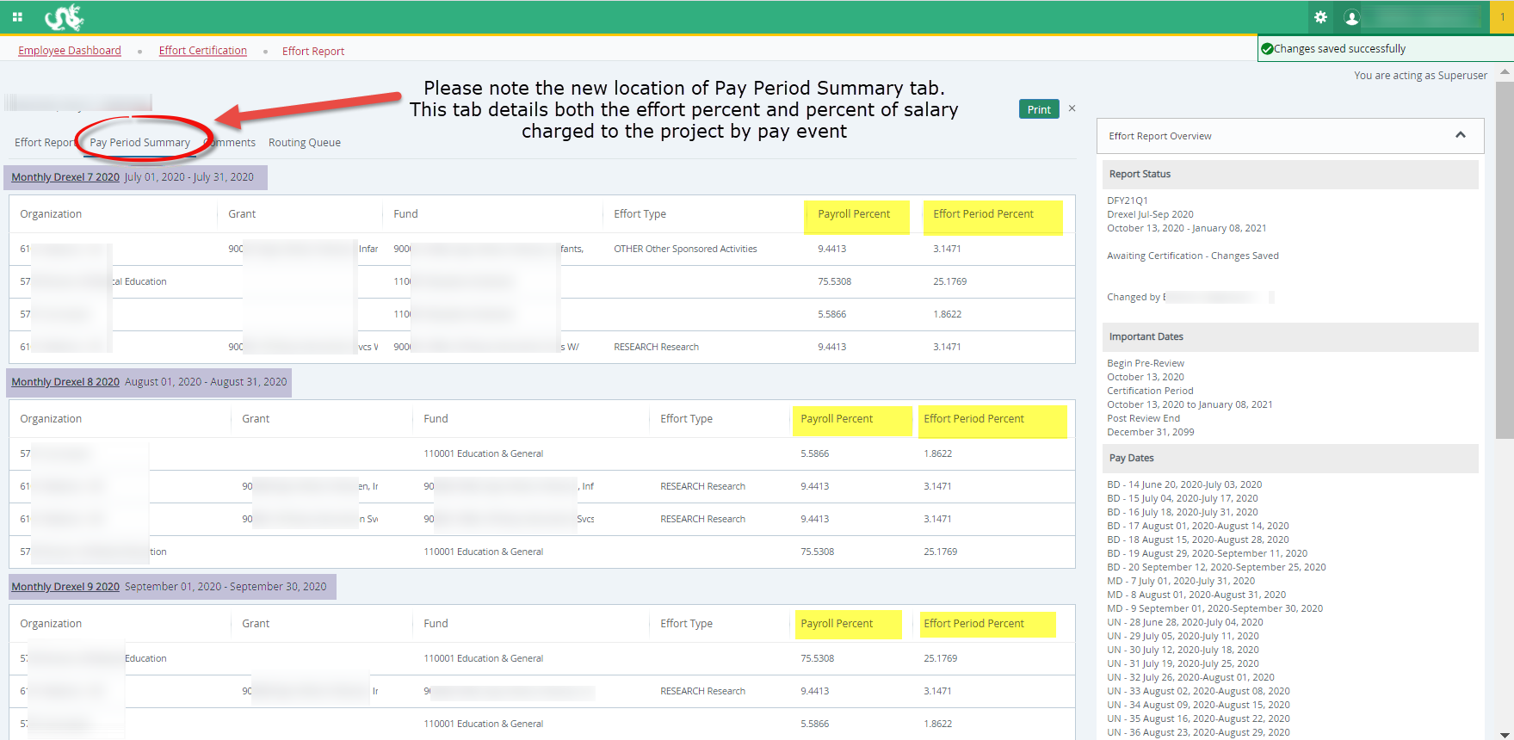
Effort Reporting Additional Information Useful Tabs on the Effort Report:
Pay Period Summary

Slide 13
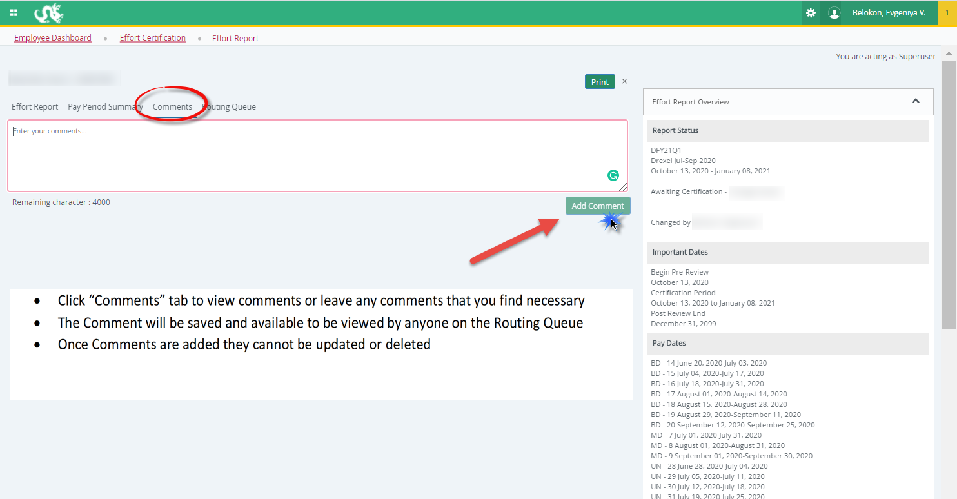
Effort Reporting Additional Information Useful Tabs on the Effort Report
Comments Tab

Slide 14
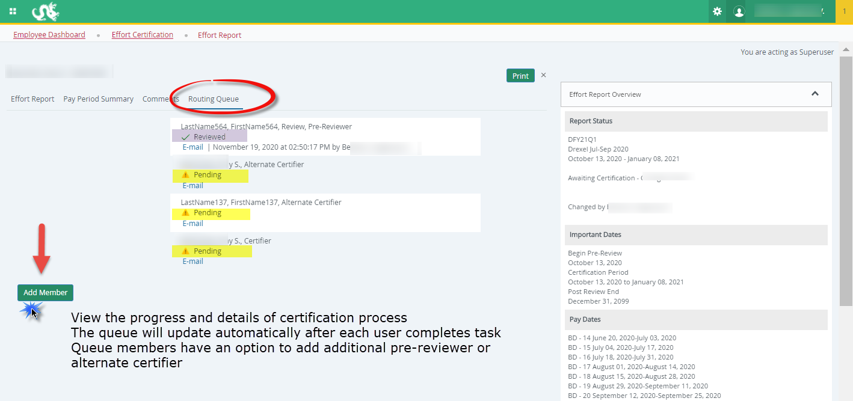
Effort Reporting Additional Information Useful Tabs on the Effort Report:
Routing Queue

Slide 15
Effort Reporting Contacts
  Contacts:
  Research Accounting Services: RAS@drexel.edu
  Gabrielle Berrios
  Associate Director, Research Accounting Services
  E-mail: gc33@drexel.edu
  Phone: 215-895-1730
  Evgeniya Belokon
  Senior Financial Analyst, Research Accounting Services
  E-mail: evb29@drexel.edu
  Phone: 215-895-6327

