Slide 1

Effort Reporting
A guide to the Drexel self-service banner effort reporting system
Revised November 2019 V1

Slide 2
Agenda
  What is Effort?
  What is Effort Reporting?
  Banner Effort Reporting Process
  Navigating Effort Reporting System as a Pre-Reviewer
  Other Effort Reporting Details

Slide 3
What is Effort?
Effort is defined as the total of all professional activities which are performed as part of an individual’s employment obligation associated with an individual’s institutional base salary. Total professional activity includes research, teaching, patient care, administrative and other University appointed activities.
Effort includes the time spent working on a sponsored project in which salary is directly charged or contributed (cost-shared).
Effort is expressed as percent of TOTAL activity and is not based on a 40-hour work week.

Slide 4
What is Effort Reporting?
Effort Reporting is a method for documenting activity expended in support of all sponsored projects. Effort reporting provides the means to verify that salaries and wages charged to sponsored awards accurately reflect the effort devoted. Federal regulations require the certification of effort expended on all sponsored awards.
Effort Reporting is done using an “after-the-fact” method and your Personal Action Form is an estimation of the allocation that was predicted for each project. If, after-the-fact, it is determined that you worked more or less on the grant than what was stated on your PAF, then a change needs to be requested.

Slide 5
Why is Effort
Reporting important?
Effort reporting:
  Provides confirmation that salary charges are appropriate
  Prevents overbilling our sponsors
  Assures sponsors of good stewardship of funds
  Documents cost sharing
  Creates a source of data for the federal indirect cost calculation
  Ensures that salary caps are enforced
  Focuses attention on cases where sponsor prior approval may be required
*Most grant expenditures are salary*

Slide 6
Who is subject to effort reporting/effort certification?
Faculty, staff, and graduate students who perform work on any sponsored project, funded directly or by a federal pass-through organization.
Undergraduate students (Student Employees and Co-Ops) who are paid through sponsored awards, certify their effort through approved time sheets.
Effort should include any work related to activities (instruction, research, administration, etc.) for which the University compensates an individual.

Slide 7
Risks of Not Reporting Effort
Audit Findings – Effort Reports are AUDITABLE
Sponsor may not reimburse for funds expended
Sponsor may require repayment of grant funds
Institution may suffer damaged reputation
Federal Lawsuits – Settlements include:
  Northwestern = $5.5 million
  Johns Hopkins = $2.6 million
  Harvard = $3.3 million

Slide 8
Benefits of Banner Effort Reporting
  Banner used for both Labor Redistribution and Effort Reporting
  Data already housed in Banner
  Banner Labor Redistribution System is integrated with Banner Effort Reporting
  Increased Transparency
  Enhance End-user Control
  Faster Updates = More Accurate and Timely Invoicing

Slide 9
Updated Procedures
Effort reports will be certified on a quarterly basis
Must be certified within the time frame allotted each quarter
If an employee is unavailable to certify their effort, the Principal Investigator or someone with first-hand knowledge must provide appropriate certification.

Slide 10
Who Certifies and How Often?
The person certifying must have first-hand knowledge of the effort expended.
Self-certification
The PI can certify on behalf of those working on their sponsored award
  If neither are available, the Chair/Dean can certify or someone with first-hand knowledge of the work completed
Effort will be released after quarter-end closes
  Deadlines will be posted on Research Accounting Services’ (RAS) website for each quarter and you will receive email communication.

Slide 11
Types of Users in Banner Effort
Pre-Reviewer:
  Person designated to review system generated effort reports for accuracy. If an error exists, the pre-reviewer will make changes to the Labor Redistribution system to correct.
    This is most likely the Departmental Administrator
Certifier:
  An employee who certifies an effort report – must have first hand knowledge.
Alternate (Proxy) Certifier:
  May certify effort reports in place of the certifier. This person must have direct knowledge of the work performed (i.e. Dean or Chair if PI has left the institution).
    Should not be the Pre-Reviewer

Slide 12
Effort Reporting System – Process Flow
Pre-Reviewer
Reviews Effort
If Correct
Clicks “Review”
Certifier
Clicks “Certify”
Complete-Locked
If not Correct
Email is sent to Pre-Reviewer to make changes
Pre-Reviewer Makes Changes in Labor Redistribution
Finance job runs
Labor Redistribution is Approved
New Effort Report Generated

Slide 13
Effort Reporting – Navigating the System as a Pre-Reviewer
A guide to the Drexel self-service banner Effort reporting system

Slide 14
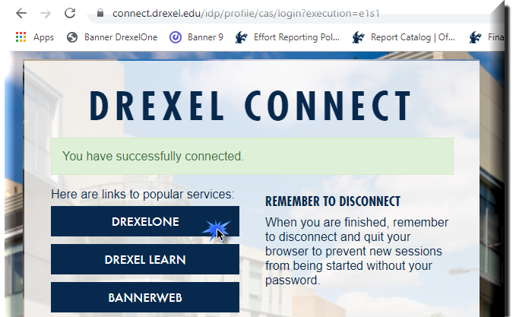
Log in to Self- Service Banner

Slide 15

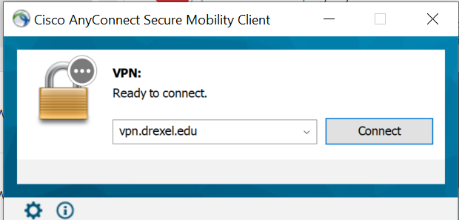
Important Update for Signing Into Effort Reporting system:
Beginning September 2020, DrexelVPN is required in order to access Effort Reporting and Labor Redistribution System. If you are trying to use Labor Redistribution/Effort Reporting from off-campus, you must log on to the Cisco AnyConnect VPN application to ensure a secure connection to the Drexel Network.
Installation Instructions for the Cisco AnyConnect VPN client can be found here: https://drexel.edu/it/help/a-z/VPN/ .

Slide 16
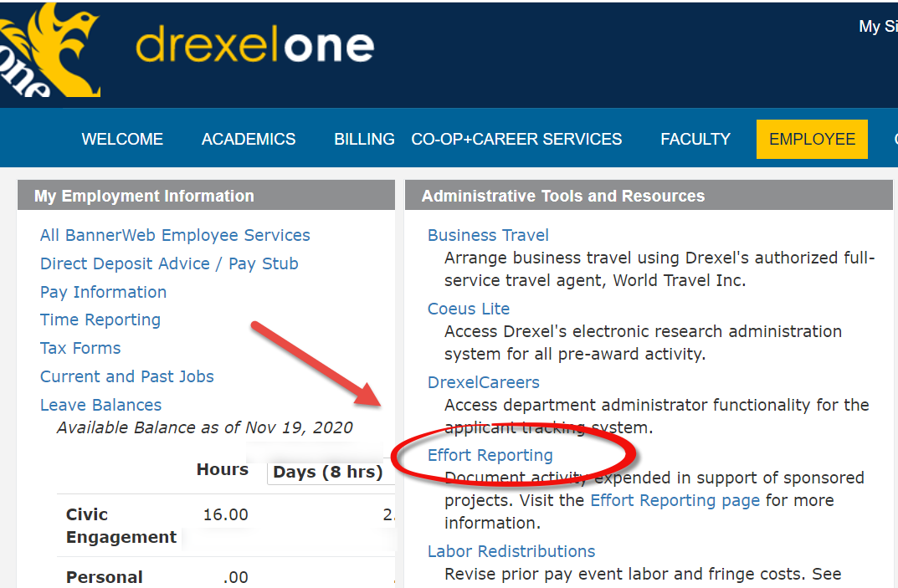
Select “Effort Reporting” link under Administrative Tools and Resources section of the Employee Main Menu tab

Slide 17
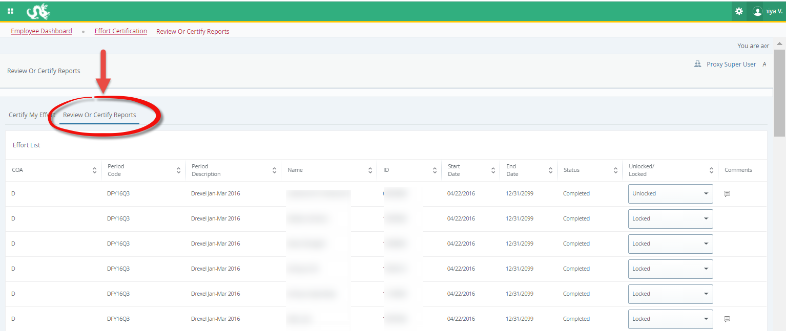
Select “Review or Certify Reports” tab

Slide 18
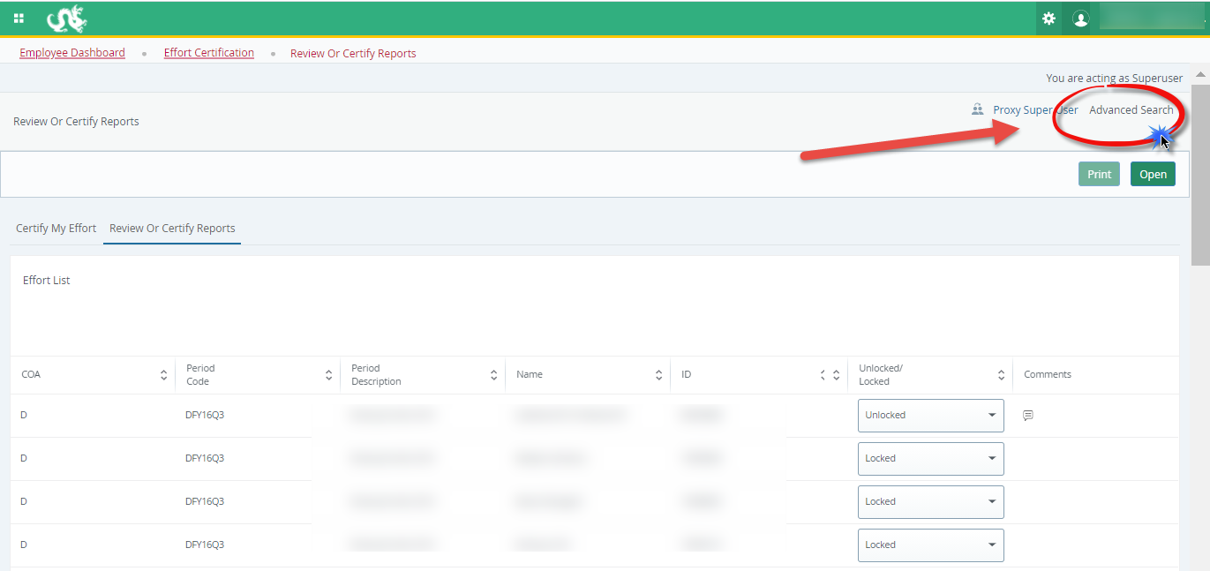
Open “Advanced Search” menu

Slide 19
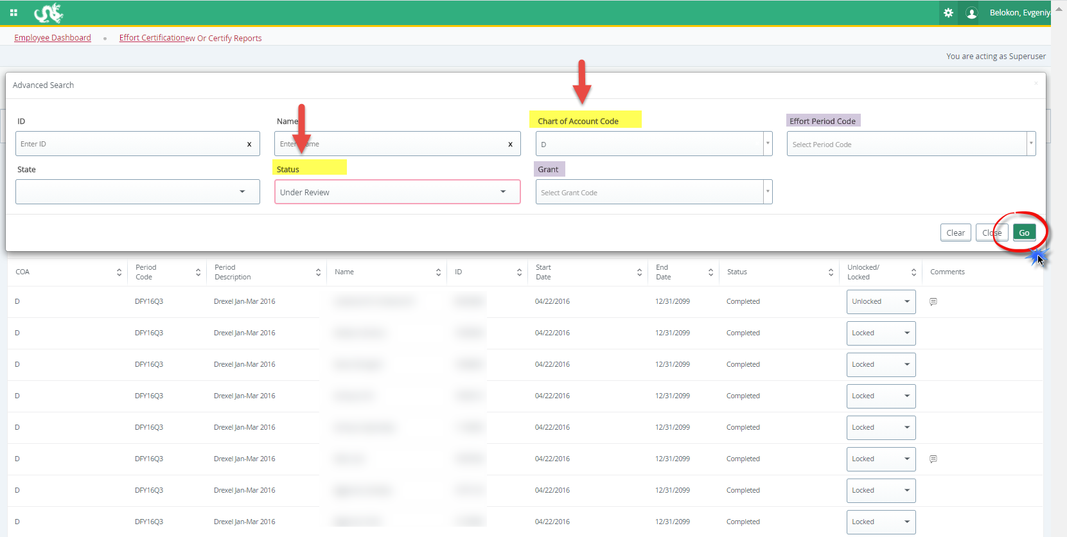
Select “Chart of Account Code”- D or S, and “Status” Under Review from the menu (you may filter further on grant/ID/name or effort period), click “Go”

Slide 20
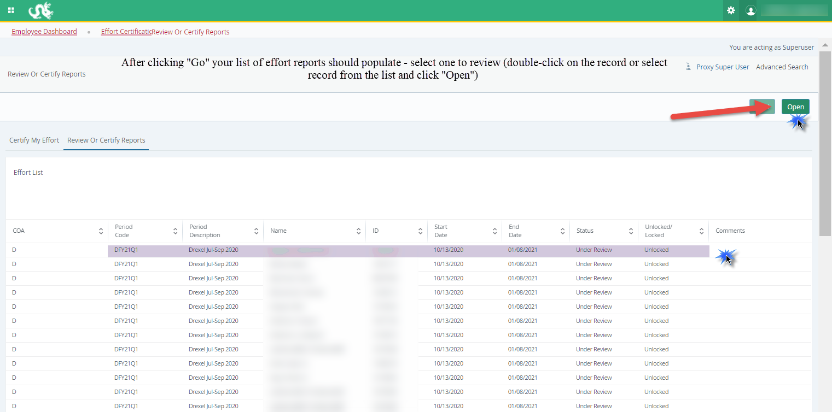

Slide 21
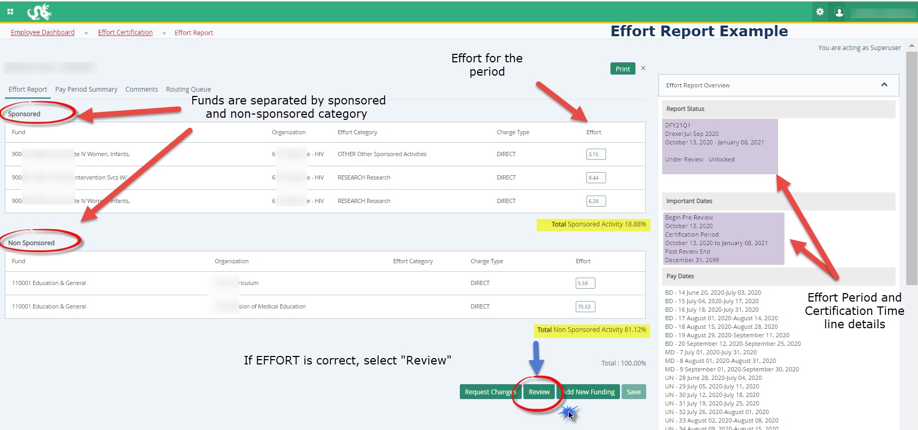
Certifier:
Certify Effort
Example Effort Report:
Click ‘Certify’ if effort is CORRECT

Slide 22
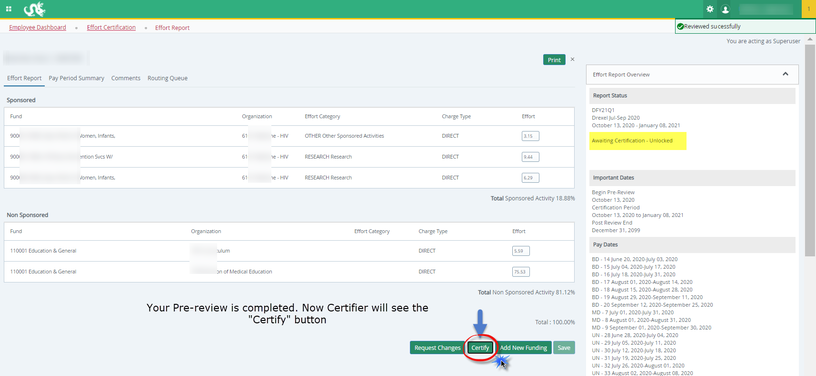

Slide 23
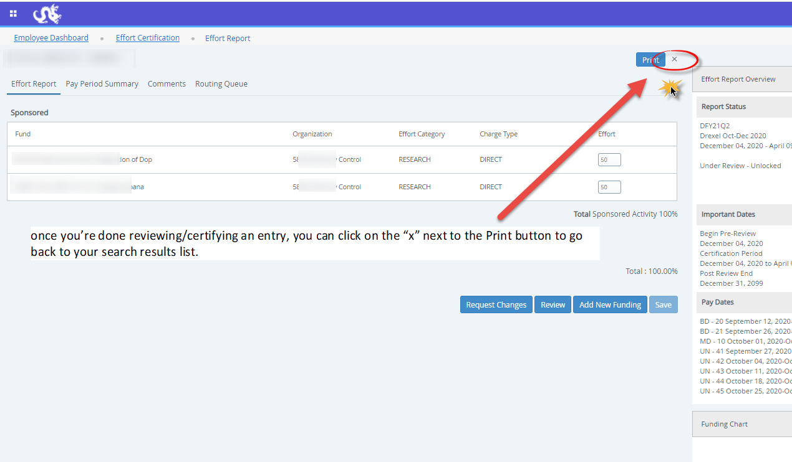

Slide 24
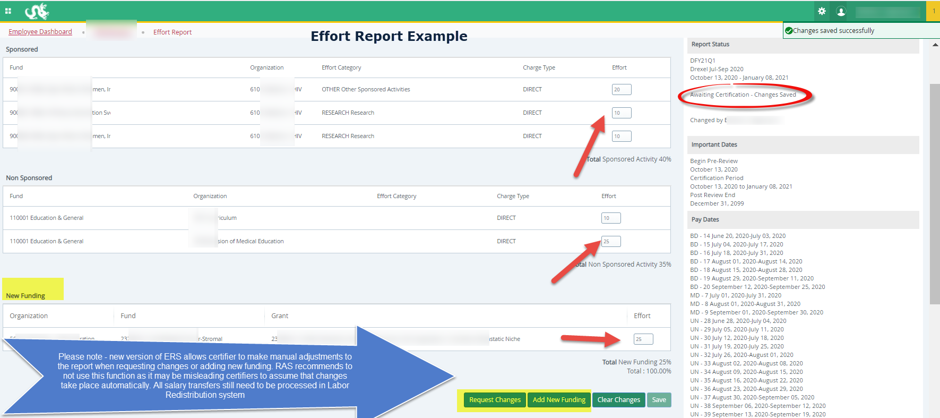

Slide 25
Pre-Reviewer: Incorrect Effort Report
If the Effort Report is not correct, do NOT select “Review.”
  Instead, send an email with the desired changes to the individual in your department who processes labor redistributions (in most cases, the pre-reviewer has access to process the labor redistributions themselves)
Make the change in the labor redistribution tab
  Change to effort will not be automatic
  Labor redistribution needs to get all of its necessary approvals
  Once it reaches disposition code of 70, labor redistribution is complete and processed in the labor redistribution system, RAS will create new effort report in Banner ERS
  Contact RAS for issues/questions

Slide 26
Pre-Reviewer: Mistake
If pre-reviewer mistakenly hits “Review”
  Contact the Certifier to choose “Request Changes”
    If the Certifier chooses “Request Changes,” the Report will be returned to the Pre-Reviewer
  Or ask RAS and RAS can return to Pre-Reviewer
    RAS@Drexel.edu

Slide 27
Effort Reporting Additional Information: Useful Tabs on the Effort Report
Pay Period Summary Tab
  To view specific payroll activity, click this tab.
Comments Tab
  Click the Comments tab to view comments or add any comments that you find necessary.
  The Comment will be saved and available to be viewed by anyone on the Routing Queue.
  Once comments are added they cannot be updated or deleted. updated or deleted.
Routing Queue Tab
  To view the progress and details of the effort certification process.
  The Routing queue shows the status of each stage of the Effort Certification process.
  The queue will update automatically after each person completes his or her task.

Slide 28
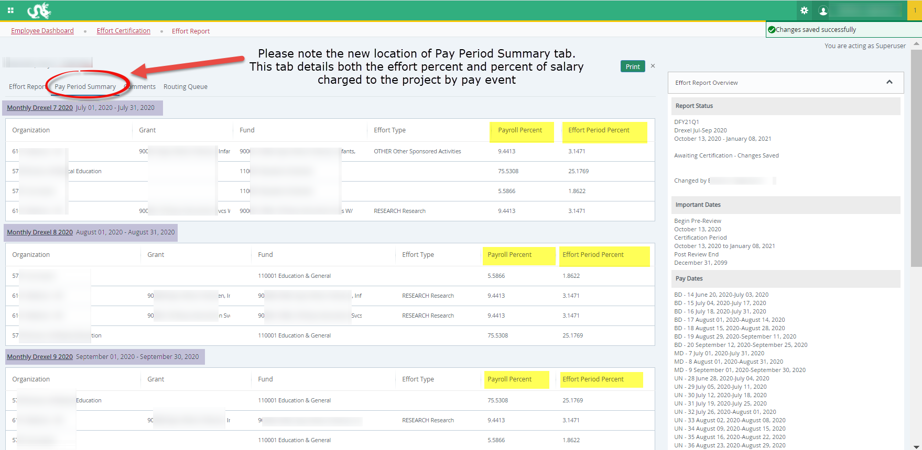
Effort Reporting Additional Information Useful Tabs on the Effort Report:
Pay Period Summary

Slide 29
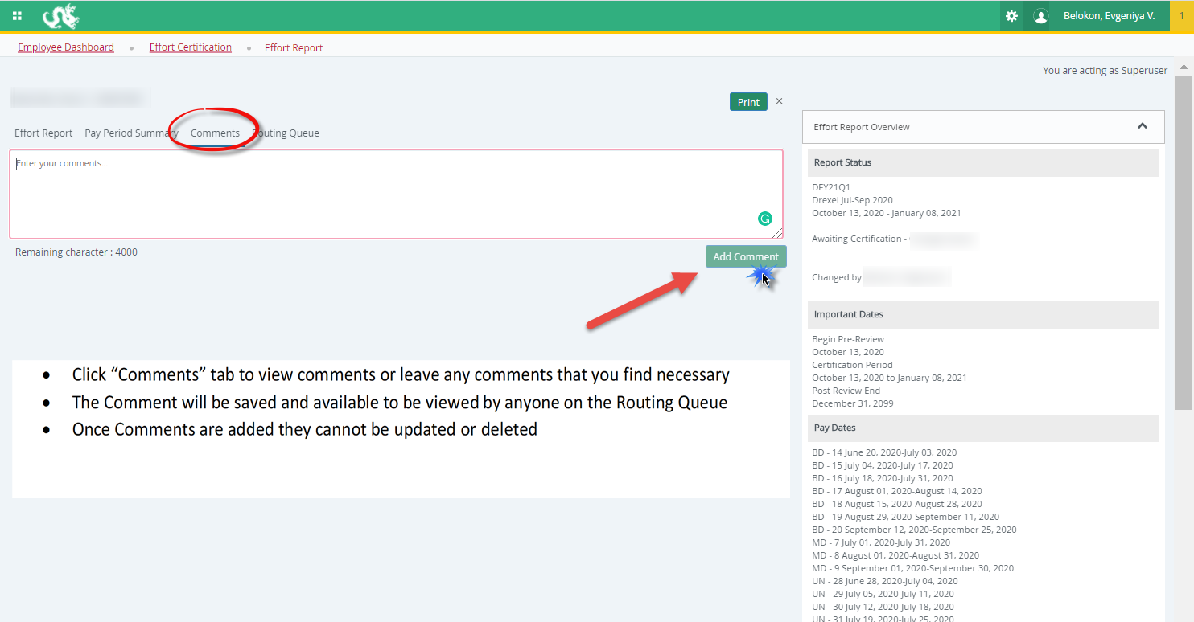
Effort Reporting Additional Information Useful Tabs on the Effort Report
Comments Tab

Slide 30
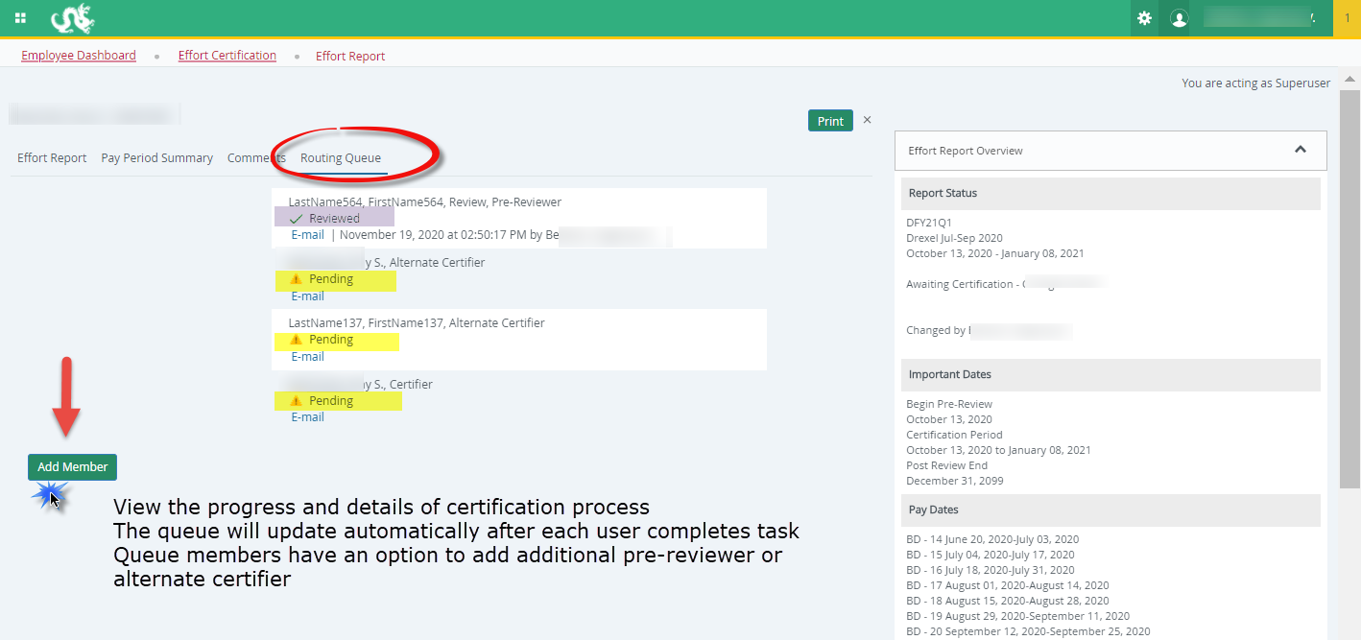
Effort Reporting Additional Information Useful Tabs on the Effort Report:
Routing Queue

Slide 31
Effort Reporting Additional Information: Types of Status/State in Pre-Reviewer’s List of Effort Reports
Status:
  Under Review: Effort report has been created and is ready to view.
  Awaiting Certification: Effort report is ready to be certified.
  Completed: Effort report has been certified and is complete.
  Awaiting Refresh: Payroll action or labor redistribution report has been completed.
State:
  Unlocked: Effort report is available for change or to be acted upon by any member in the routing queue.
  Locked: Effort report can no longer be updated.
  Changes Submitted: Changes have been made to the effort report on the effort tab.

Slide 32
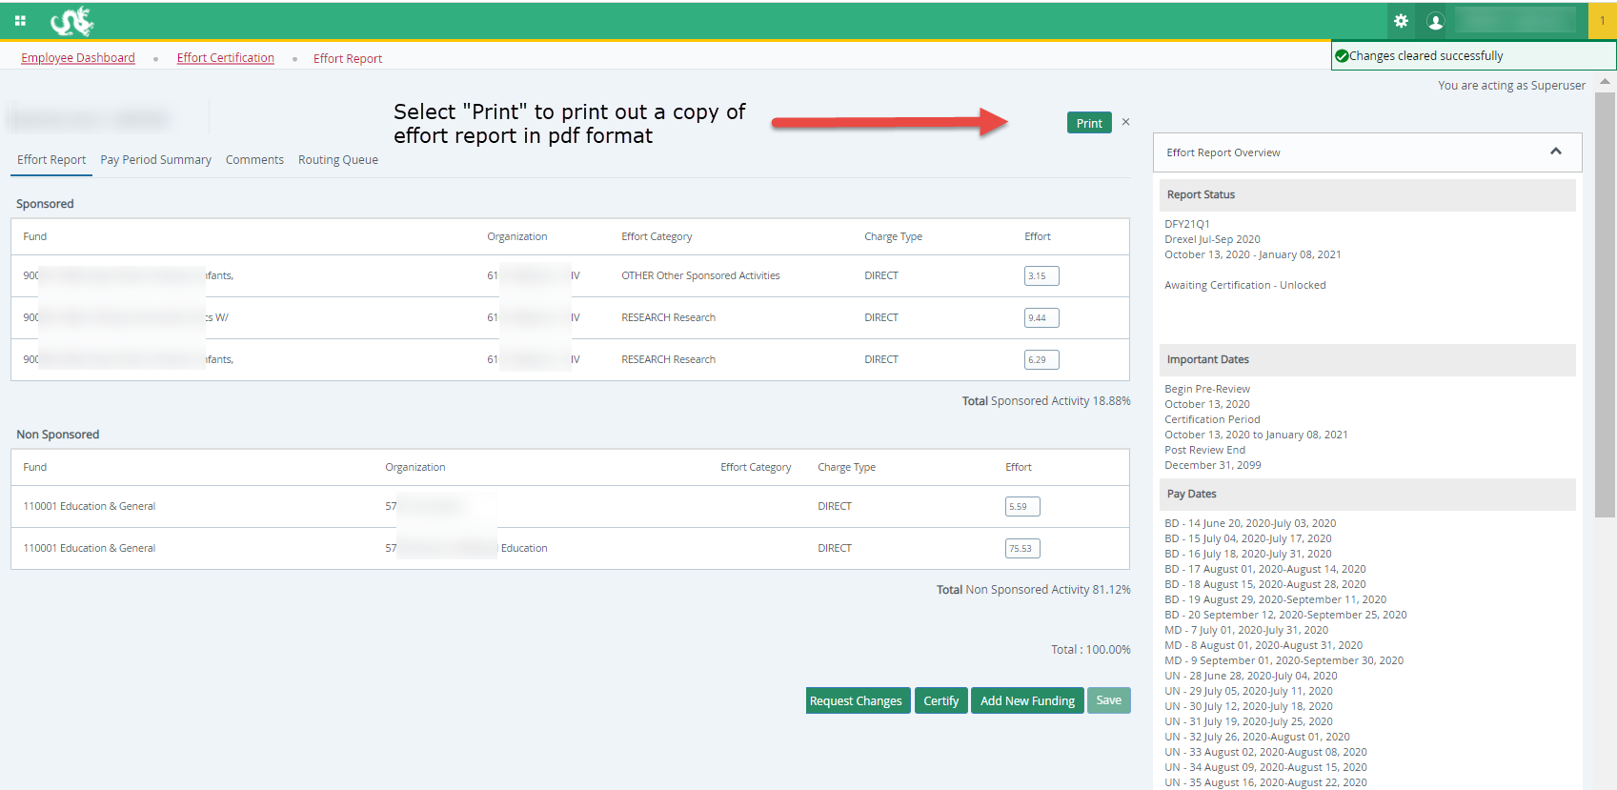
Print a Report

Slide 33
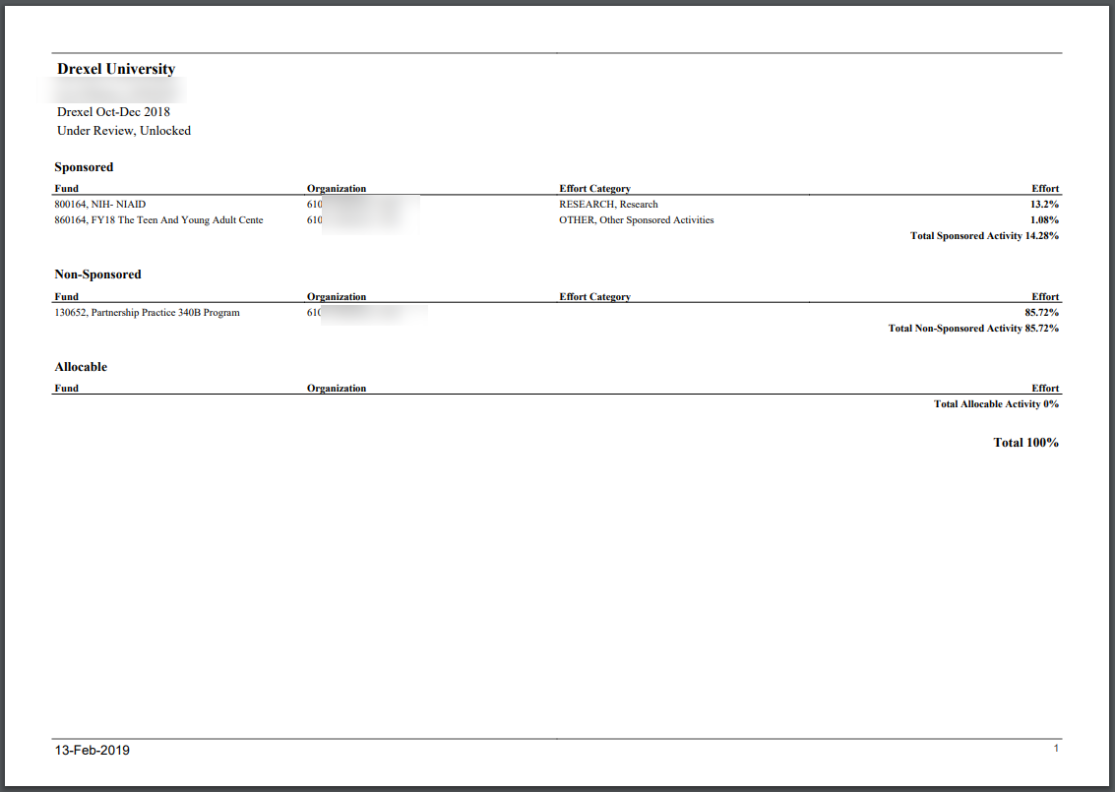

Slide 34
Locked Records
Once an effort report is in the status of Completed – Locked, all action buttons are removed, and changes cannot be done.
Once certification is complete (Locked), recertification should not occur.
In the rare event that re-certification is necessary, please contact Research Accounting Services.
  This requires further review and approval.

Slide 35
Adding Additional Pre-Reviewer or Alternate Certifier to the Routing Queue
A guide to the Drexel self-service banner effort reporting system

Slide 36
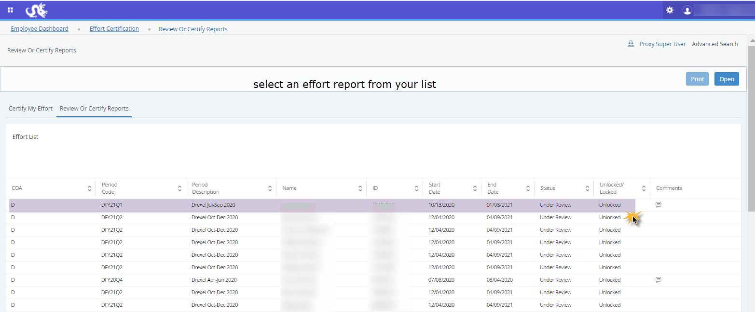
Select an effort report from your list

Slide 37
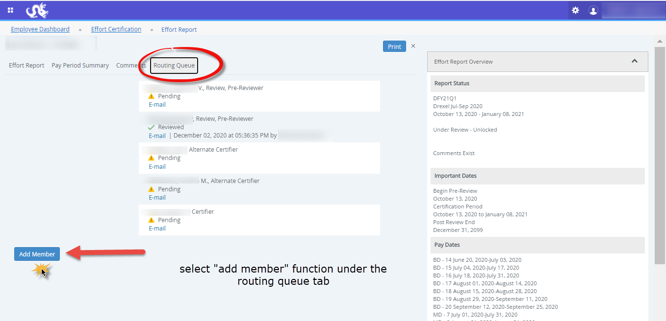

Slide 38
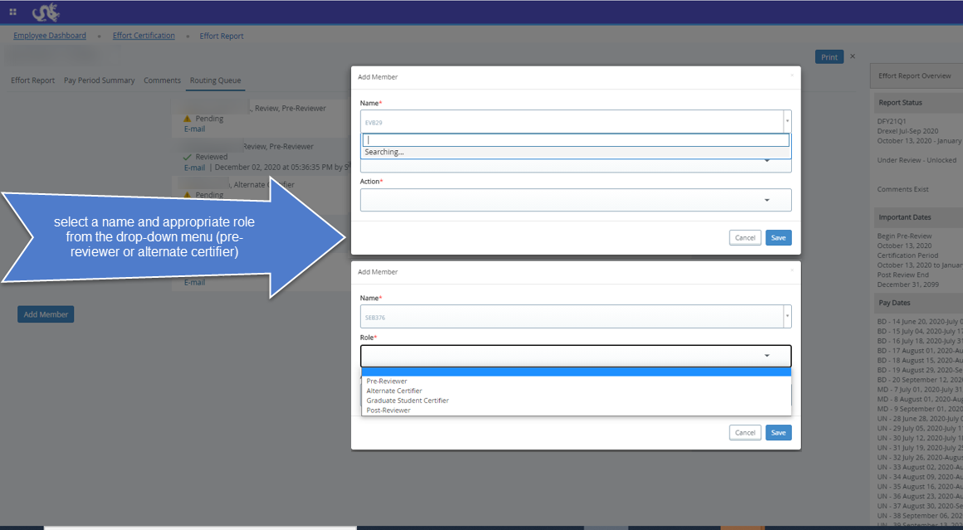

Slide 39
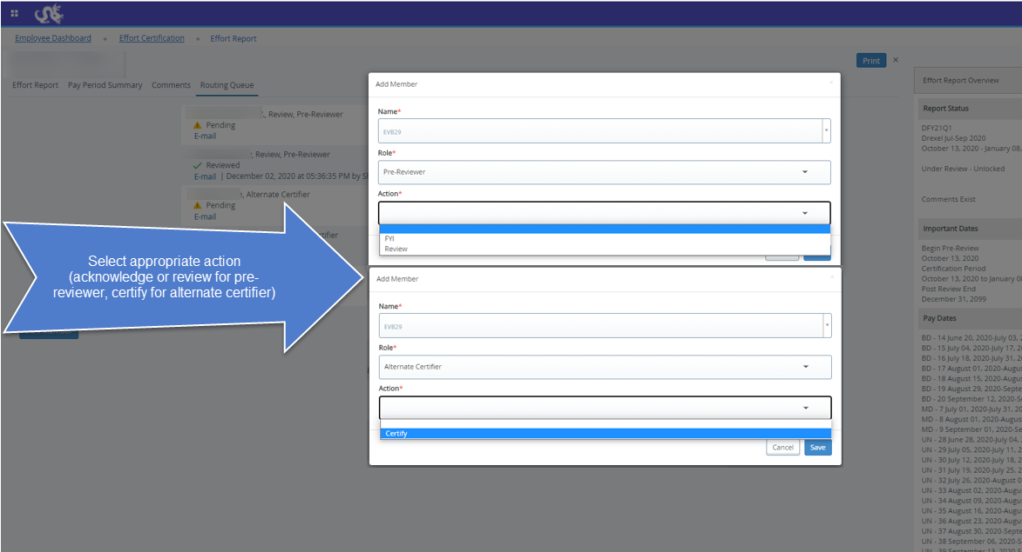

Slide 40
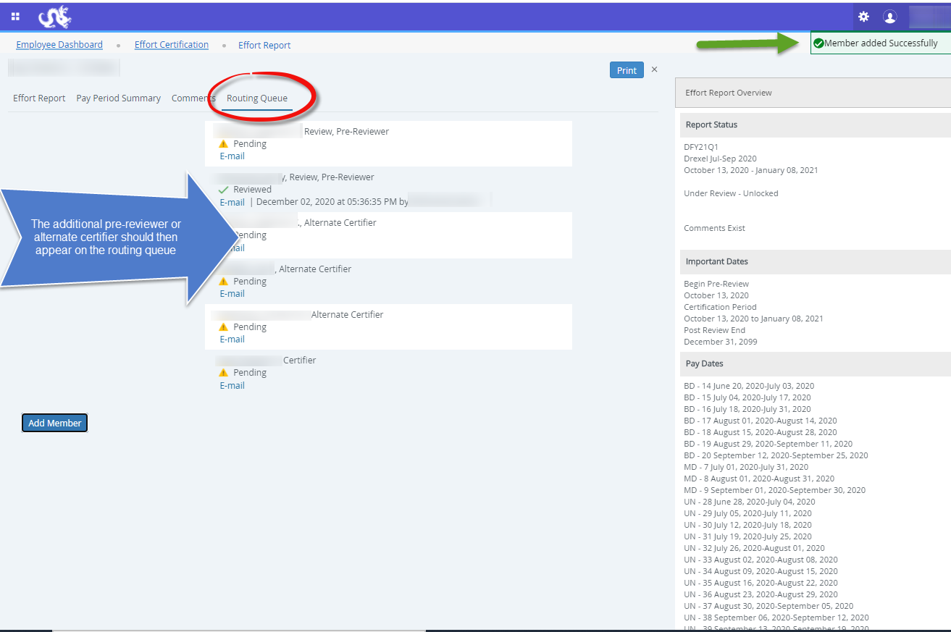

Slide 41
Other Effort Reporting Details
A guide to the Drexel self-service banner effort reporting system

Slide 42
Cost Share
Cost Share effort is captured on the Effort Report.
Cost Shared effort will be brought into the Effort Report.
In terms of cost-sharing effort, the University normally only cost shares effort when mandated in the sponsor’s written guidelines. If cost-sharing is not mandatory, it is the University’s policy to abstain from cost-sharing.
All non-sponsored funds are brought in as part of the complete salary portfolio.

Slide 43
Faculty/Staff 100% on Research Grant
If a faculty member is charged 100% to grant accounts, it means that they are doing NOTHING but funded research. If a faculty member is writing grant proposals, serving on committees, etc. it is not appropriate to claim 100% effort on grant accounts.

Slide 44
Minimum Effort on a Grant/Contract
It is expected that all PIs and other key personnel will have a defined level of effort during the performance of a grant, including industrially sponsored clinical trials.
  Furthermore, NIH has noted that “zero percent” effort or “as needed” is not an acceptable level of involvement for Senior/Key Personnel.

Slide 45
Effort Reporting Contacts
  Contacts:
  Research Accounting Services: RAS@drexel.edu
  Gabrielle Berrios
  Associate Director, Research Accounting Services
  E-mail: gc33@drexel.edu
  Phone: 215-895-1730
  Evgeniya Belokon
  Senior Financial Analyst, Research Accounting Services
  E-mail: evb29@drexel.edu
  Phone: 215-895-6327

Slide 46
Quick Links
http://drexel.edu/research/
http://drexel.edu/research/research-accounting/overview/
https://one.drexel.edu/web/university
https://www.whitehouse.gov/omb/grants_docs
http://grants.nih.gov/grants/policy/salcap_summary.htm
Contact Research Accounting Services: RAS@drexel.edu
Questions regarding Labor Redistribution System: HRIS@drexel.edu

Slide 47

Questions?

