Slide 1
Effort Reporting
A guide to the Drexel self-service banner effort reporting system

Slide 2
Agenda
What is Effort?
What is Effort Reporting?
Banner Effort Reporting Process
Guide to Navigating Effort Reporting System
Other Effort Reporting Details

Slide 3
What is Effort?
Effort is defined as the total of all professional activities which are performed as part of an individual’s employment obligation associated with an individual’s institutional base salary. Total professional activity includes research, teaching, patient care, administrative and other University appointed activities.
Effort includes the time spent working on a sponsored project in which salary is directly charged or contributed (cost-shared).
Effort is expressed as percent of TOTAL activity and is not based on a 40-hour work week.

Slide 4
What is Effort Reporting?
Effort Reporting is a method for documenting activity expended in support of all sponsored projects. Effort reporting provides the means to verify that salaries and wages charged to sponsored awards accurately reflect the effort devoted. Federal regulations require the certification of effort expended on all sponsored awards.
Effort Reporting is done using an “after-the-fact” method and your Personal Action Form is an estimation of the allocation that was predicted for each project. If, after-the-fact, it is determined that you worked more or less on the grant than what was stated on your PAF, then a change needs to be requested.

Slide 5
Why is Effort Reporting important?
Effort reporting:
Provides confirmation that salary charges are appropriate
Prevents overbilling our sponsors
Assures sponsors of good stewardship of funds
Documents cost sharing
Creates a source of data for the federal indirect cost calculation
Ensures that salary caps are enforced
Focuses attention on cases where sponsor prior approval may be required
*Most grant expenditures are salary*

Slide 6
Who is subject to effort reporting/effort certification?
Faculty, staff, and graduate students who perform work on any sponsored project, funded directly or by a federal pass-through organization.
Undergraduate students (Student Employees and Co-Ops) who are paid through sponsored awards, certify their effort through approved time sheets.
Effort should include any work related to activities (instruction, research, administration, etc.) for which the University compensates an individual.

Slide 7
Risks of Not Reporting Effort
Audit Findings – Effort Reports are AUDITABLE
Sponsor may not reimburse for funds expended
Sponsor may require repayment of grant funds
Institution may suffer damaged reputation
Federal Lawsuits – Settlements include:
Northwestern = $5.5 million
Johns Hopkins = $2.6 million
Harvard = $3.3 million

Slide 8
Benefits of Banner Effort Reporting
Banner used for both Labor Redistribution and Effort Reporting
Data already housed in Banner
Banner Labor Redistribution System is integrated with Banner Effort Reporting
Increased Transparency
Enhance End-user Control
Faster Updates = More Accurate and Timely Invoicing

Slide 9
Updated Procedures
Effort reports will be certified on a quarterly basis
Must be certified within the time frame allotted each quarter
If an employee is unavailable to certify their effort, the Principal Investigator or someone with first-hand knowledge must provide appropriate certification.

Slide 10
Who Certifies and How Often?
The person certifying must have first-hand knowledge of the effort expended.
Self-certification
The PI can certify on behalf of those working on their sponsored award
If neither are available, the Chair/Dean can certify or someone with first-hand knowledge of the work completed
Effort will be released after quarter-end closes
Deadlines will be posted on Research Accounting Services’ (RAS) website for each quarter and you will receive email communication.

Slide 11
Types of Users in Banner Effort
Pre-Reviewer:
Person designated to review system generated effort reports for accuracy. If an error exists, the pre-reviewer will make changes to the Labor Redistribution system to correct.
This is most likely the Departmental Administrator
Certifier:
An employee who certifies an effort report – must have first hand knowledge.
Alternate (Proxy) Certifier:
May certify effort reports in place of the certifier. This person must have direct knowledge of the work performed (i.e. Dean or Chair if PI has left the institution).
Should not be the Pre-Reviewer

Slide 12
Effort Reporting System – Process Flow
Pre-Reviewer
Reviews Effort
If Correct
Clicks “Review”
Certifier
Clicks “Certify”
Complete-Locked
If not Correct
Email is sent to Pre-Reviewer to make changes
Pre-Reviewer Makes Changes in Labor Redistribution
Finance job runs
Labor Redistribution is Approved
New Effort Report Generated

Slide 13
Effort Reporting – Navigating the System as a Certifier
A guide to the Drexel self-service banner effort reporting system

Slide 14
Certifier
Receives notification that effort report is awaiting certification
Certifier checks that effort is captured accurately
If correct, hit “Certify” and agree to the certification
If Certifier does NOT agree:
Email with the desired changes should be sent back to the pre-reviewer

Slide 15
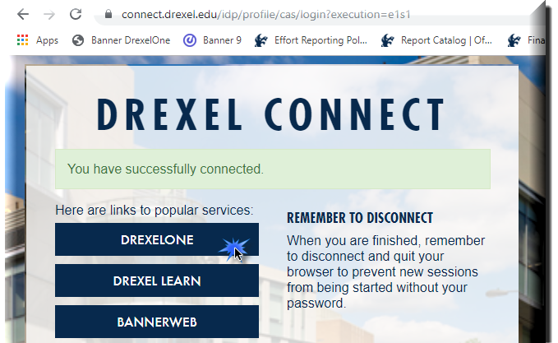
Log in to Self- Service Banner

Slide 16
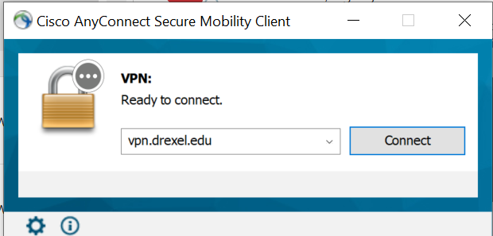
Important Update for Signing Into Effort Reporting system:
Beginning September 2020, DrexelVPN is required in order to access Effort Reporting and Labor Redistribution System. If you are trying to use Labor Redistribution/Effort Reporting from off-campus, you must log on to the Cisco AnyConnect VPN application to ensure a secure connection to the Drexel Network.
Installation Instructions for the Cisco AnyConnect VPN client can be found here: https://drexel.edu/it/help/a-z/VPN/ .

Slide 17
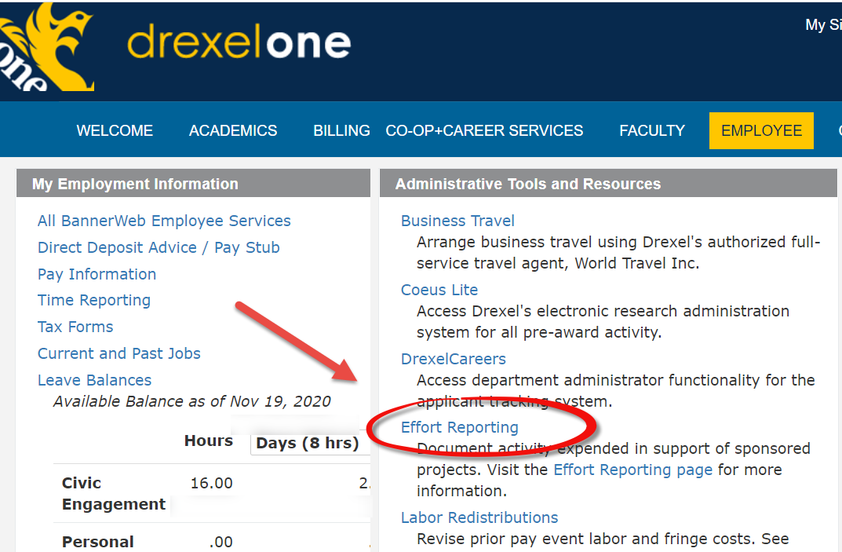
Select “Effort Reporting” link under Administrative Tools and Resources section of the Employee Main Menu tab

Slide 18
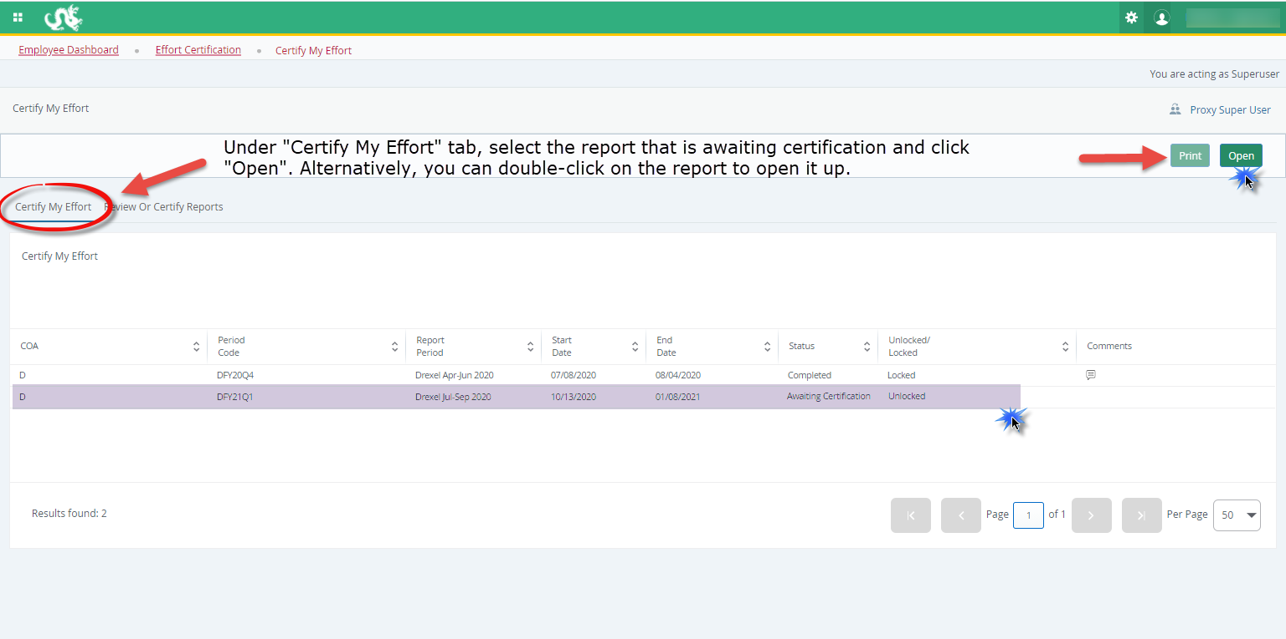

Slide 19
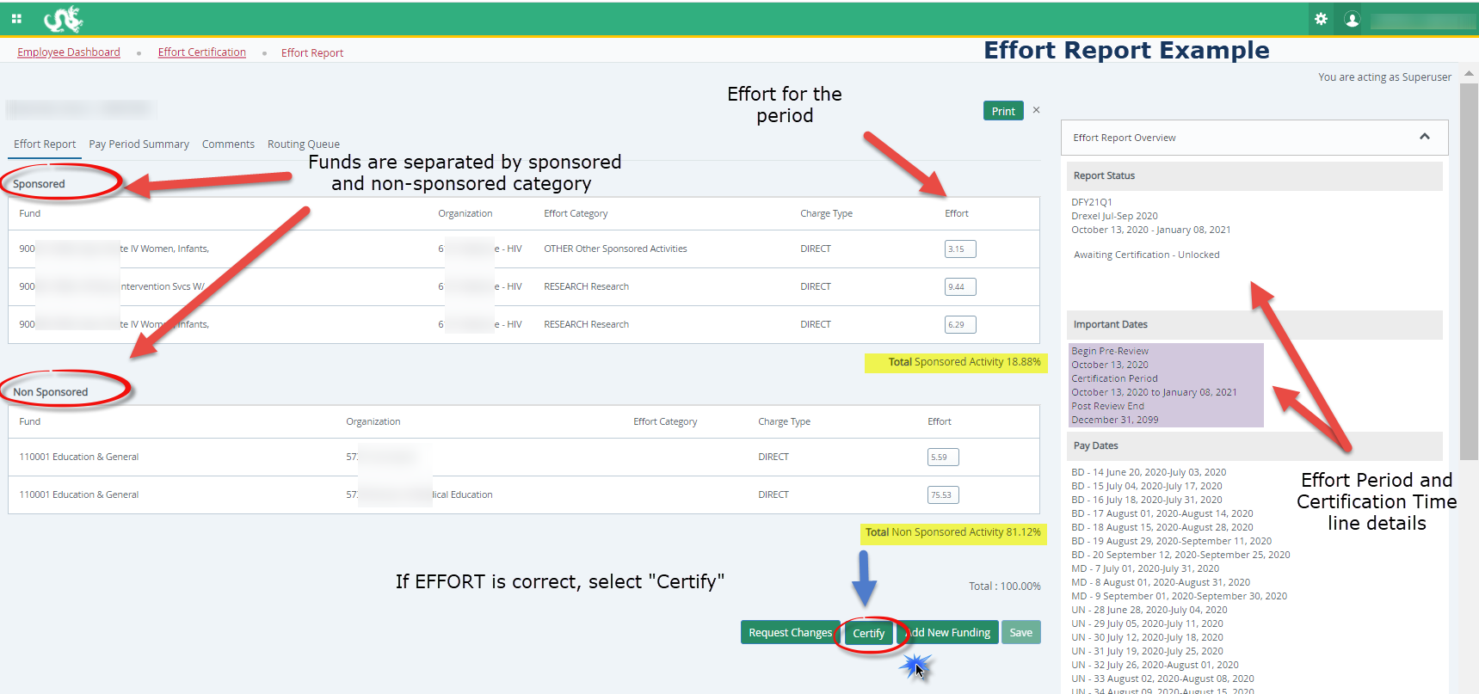
Certifier: Certify Effort
Example Effort Report:
Click ‘Certify’ if effort is CORRECT

Slide 20
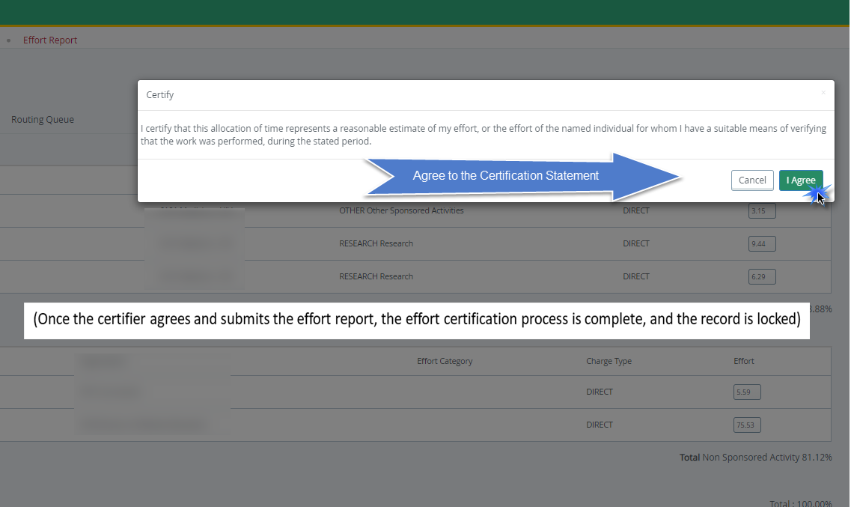
Certifier: Certify
(Once the certifier agrees and submits the effort report, the effort certification process is complete, and the record is locked)

Slide 21
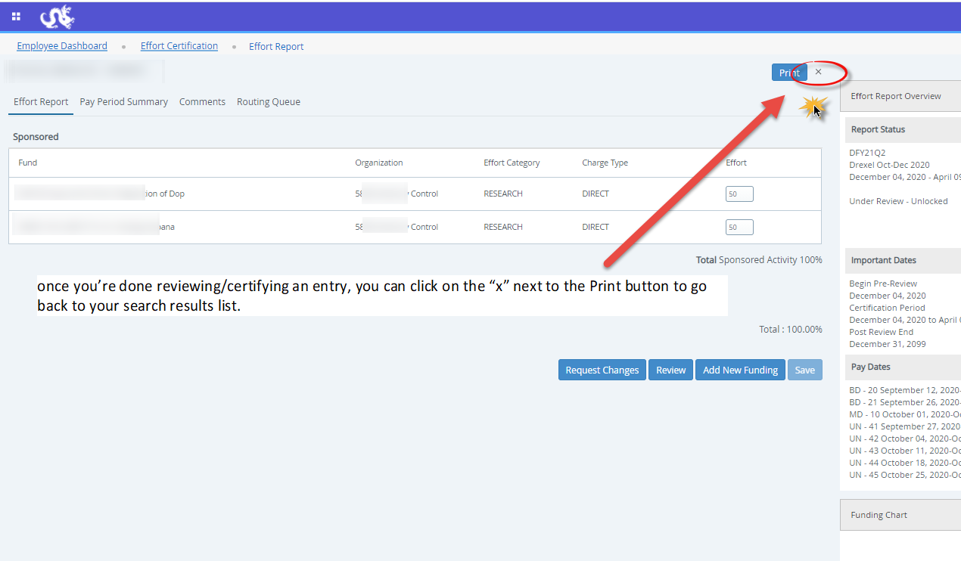

Slide 22
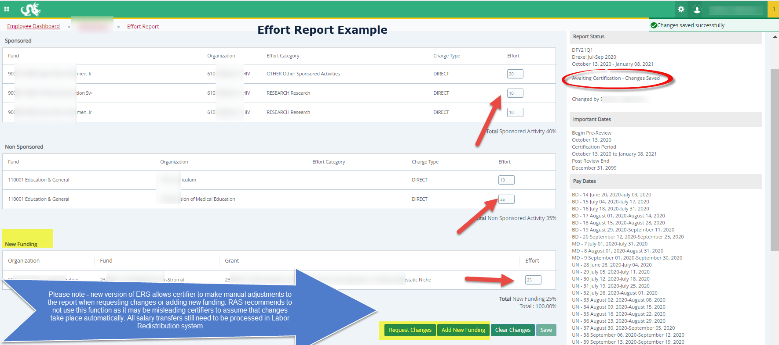

Slide 23
Locked Records
Once an effort report is in the status of Completed – Locked, all action buttons are removed, and changes cannot be done.
Once certification is complete (Locked), recertification should not occur.
In the rare event that re-certification is necessary, please contact Research Accounting Services.
This requires further review and approval.

Slide 24
Certifier: Incorrect Effort Report
If the Effort Report is not correct, do NOT select “Certify”
Instead, send an email with the desired changes to the individual in your department who processes labor redistributions (in most cases, pre-reviewer has access to process the labor redistributions themselves)
Make the change in the labor redistribution tab
Change to effort will not be automatic
Labor redistribution needs to get all its necessary approvals
Once it reaches disposition code of 70, labor redistribution is complete and processed in the labor redistribution system, RAS will create new effort report in Banner ERS
Contact RAS for issues/questions

Slide 25
Effort Reporting Additional Information: Useful Tabs on the Effort Report
Pay Period Summary Tab
To view specific payroll activity, click this tab.
Comments Tab
Click the Comments tab to view comments or add any comments that you find necessary.
The Comment will be saved and available to be viewed by anyone on the Routing Queue.
Once comments are added they cannot be updated or deleted. updated or deleted.
Routing Queue Tab
To view the progress and details of the effort certification process.
The Routing queue shows the status of each stage of the Effort Certification process.
The queue will update automatically after each person completes his or her task.

Slide 26
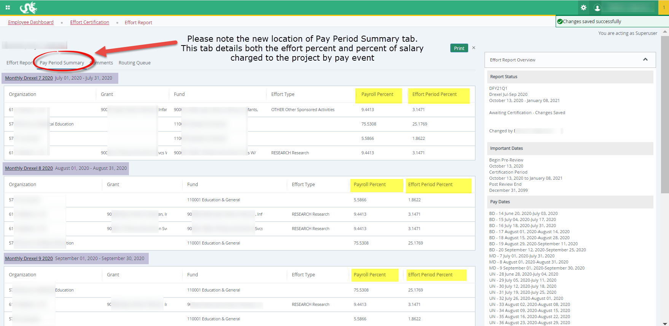
Effort Reporting Additional Information Useful Tabs on the Effort Report: Pay Period Summary

Slide 27
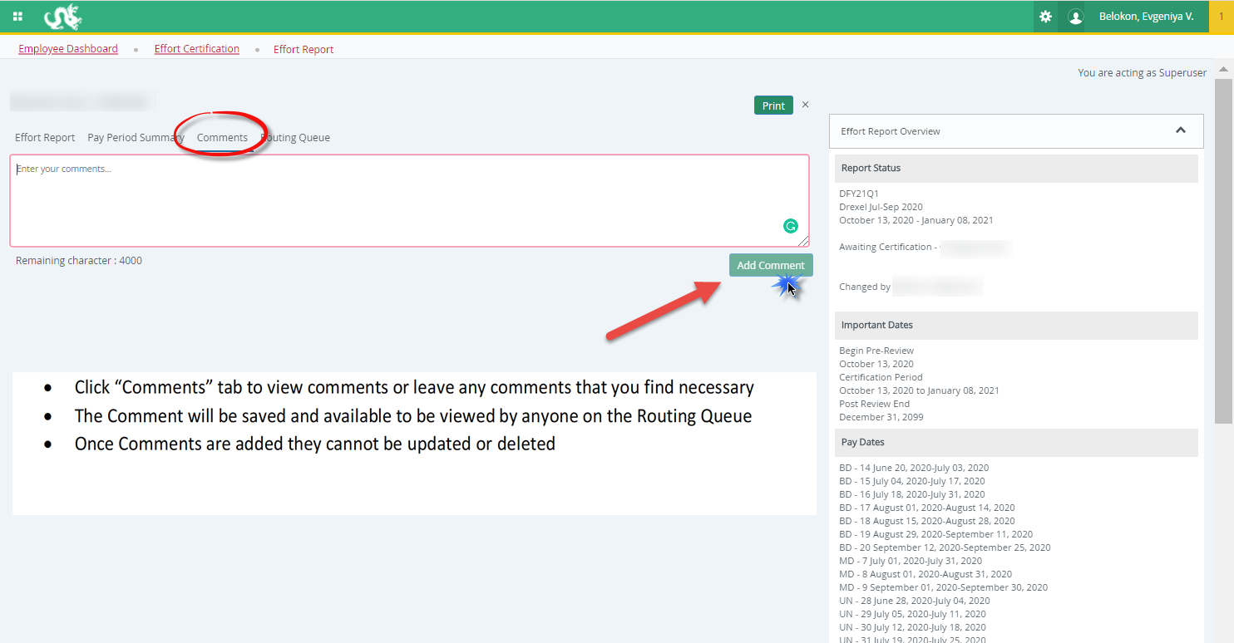
Effort Reporting Additional Information Useful Tabs on the Effort Report Comments Tab

Slide 28
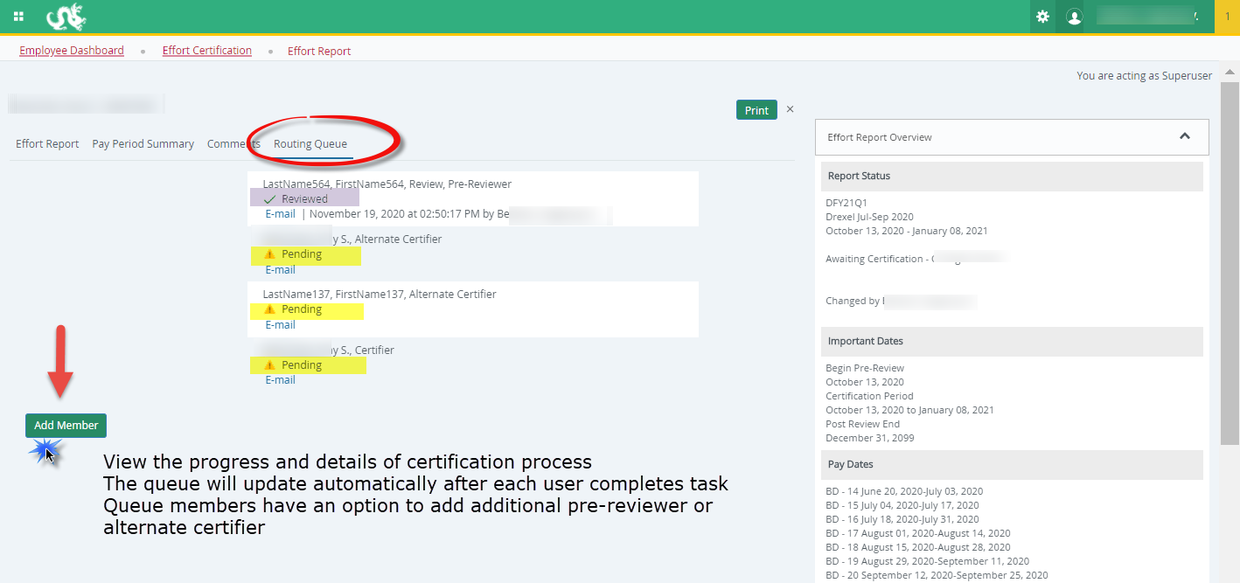
Effort Reporting Additional Information Useful Tabs on the Effort Report: Routing Queue

Slide 29
Effort Reporting – Navigating the System as an Alternate Certifier
A guide to the Drexel self-service banner effort reporting system

Slide 30
Log in to Self- Service Banner

Slide 31
Select “Effort Reporting” link under Administrative Tools and Resources section of Employee menu

Slide 32
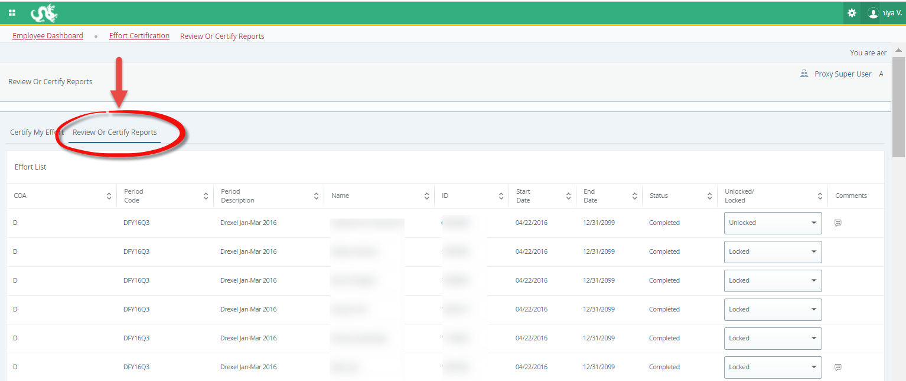
Select “Review or Certify Reports” tab

Slide 33
Open “Advanced Search” menu

Slide 34
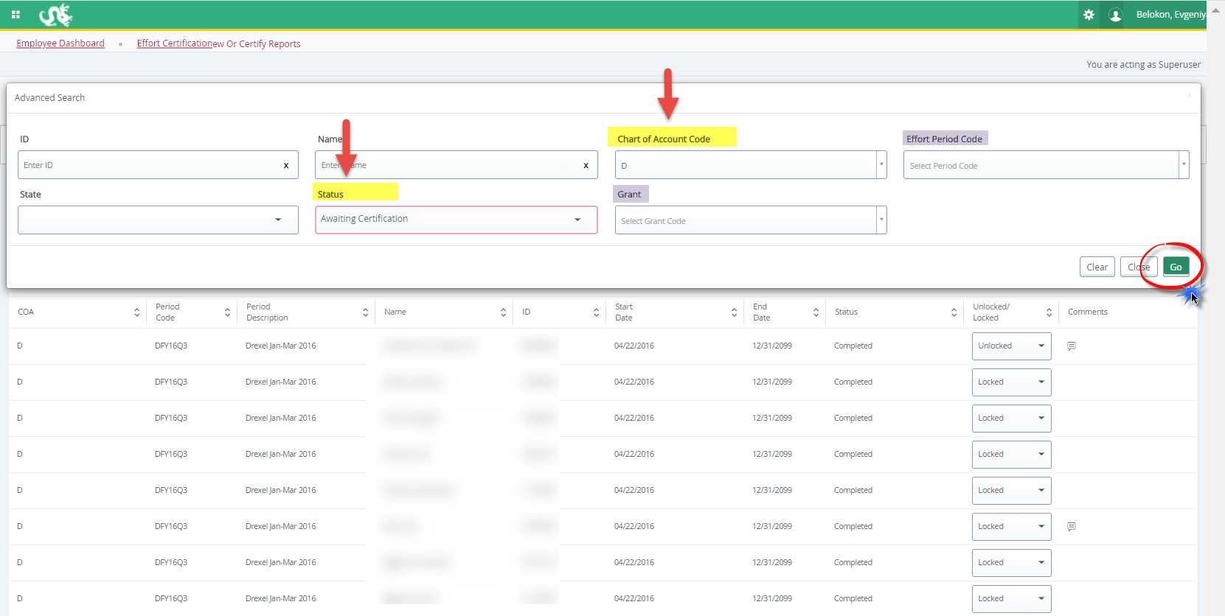
Select “Chart of Account Code” – D or S, and “Status” Awaiting Certification from the menu (you may filter further on grant/ID/name or effort period), click “Go”

Slide 35
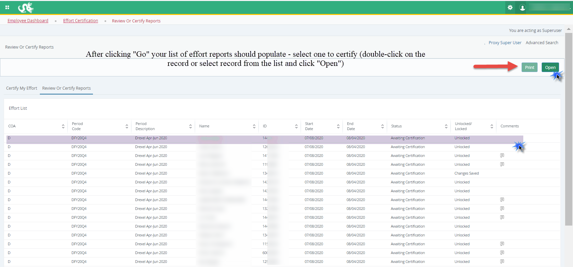
Alternate Certifier: Reports Populate

Slide 36
Certifier: Certify Effort
Example Effort Report:
Click ‘Certify’ if effort is CORRECT

Slide 37
Certifier: Certify
(Once the certifier agrees and submits the effort report, the effort certification process is complete, and the record is locked)

Slide 39
Alternate Certifier: Incorrect Effort Report
If the Effort Report is not correct, do NOT select “Certify.”
Instead, send an email with the desired changes to the pre-reviewer (if you are unsure of who the pre-reviewer is for an effort report, you may check this in the ‘Routing Queue’ tab on the left side of the effort report)
The pre-reviewer will then submit the change and the effort report will be recreated to reflect your desired changes. Communicate with the pre-reviewer to find out when the change has been made so that you can go back in to certify.

Slide 40
Adding Additional Pre-Reviewer or Alternate Certifier to the Routing Queue
A guide to the Drexel self-service banner effort reporting system

Slide 41
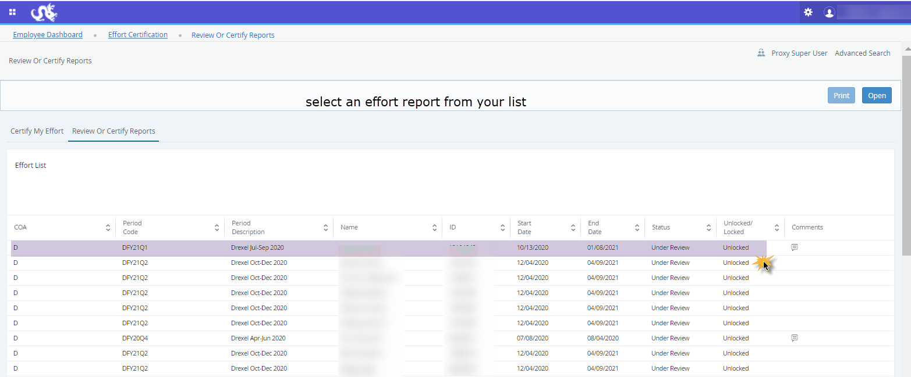
Select an effort report from your list

Slide 42
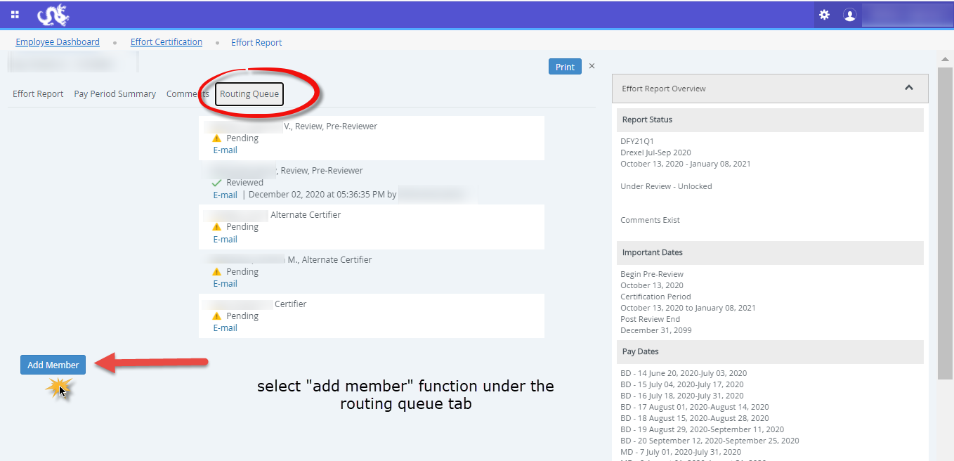

Slide 43
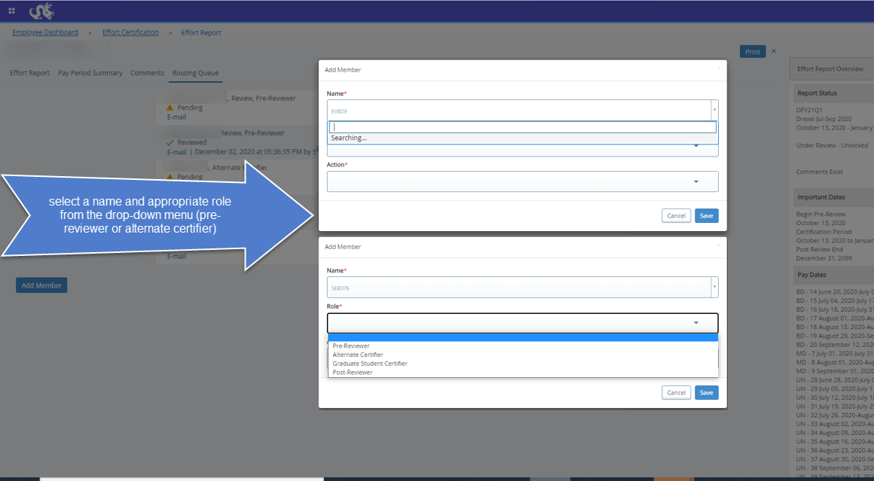

Slide 44
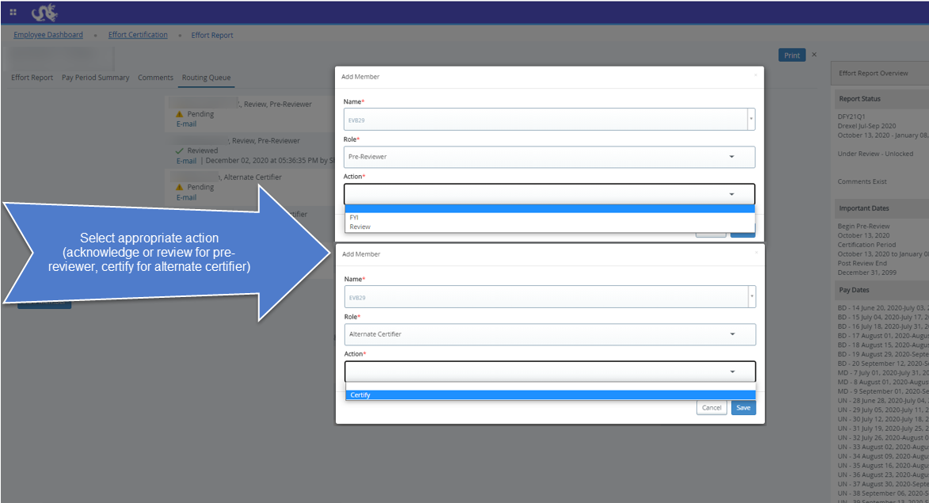

Slide 45
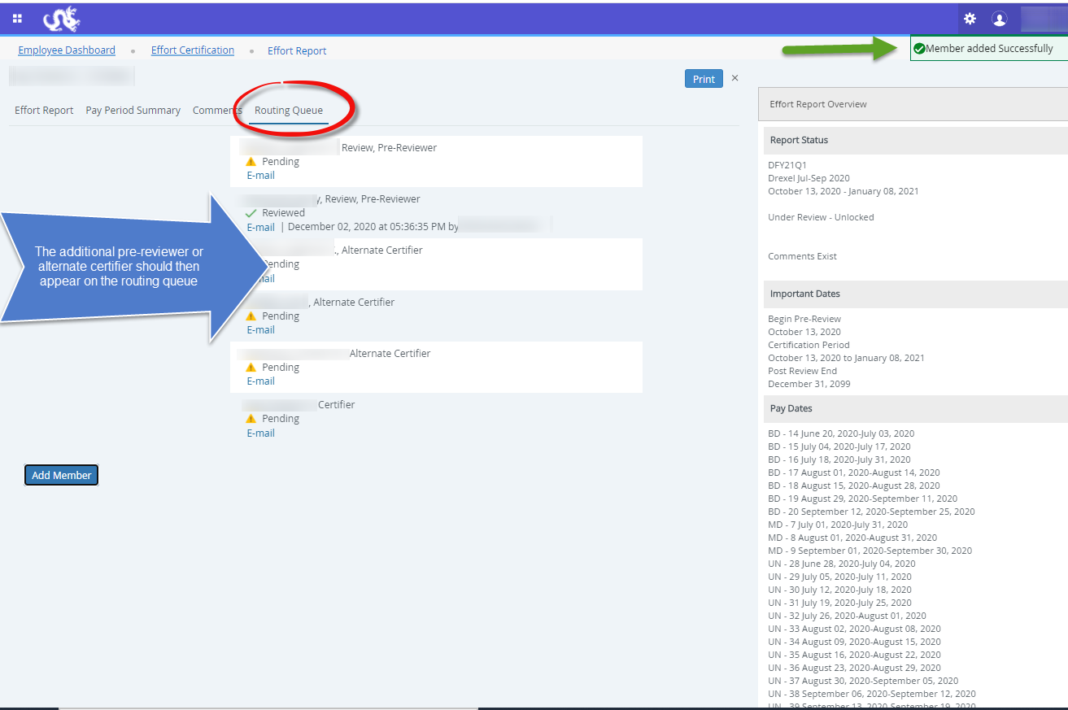

Slide 46
Other Effort Reporting Details
A guide to the Drexel self-service banner Effort reporting system

Slide 47
Cost Share
Cost Share effort is captured on the Effort Report.
Cost Shared effort will be brought into the Effort Report.
In terms of cost-sharing effort, the University normally only cost shares effort when mandated in the sponsor’s written guidelines. If cost-sharing is not mandatory, it is the University’s policy to abstain from cost-sharing.
All non-sponsored funds are brought in as part of the complete salary portfolio.

Slide 48
Faculty/Staff 100% on Research Grant
If a faculty member is charged 100% to grant accounts, it means that they are doing NOTHING but funded research. If a faculty member is writing grant proposals, serving on committees, etc. it is not appropriate to claim 100% effort on grant accounts.

Slide 49
Minimum Effort on a Grant/Contract
It is expected that all PIs and other key personnel will have a defined level of effort during the performance of a grant, including industrially sponsored clinical trials.
Furthermore, NIH has noted that “zero percent” effort or “as needed” is not an acceptable level of involvement for Senior/Key Personnel.

Slide 50
Effort Reporting Contacts
Contacts:
Research Accounting Services: RAS@drexel.edu
Gabrielle Berrios
Associate Director, Research Accounting Services
E-mail: gc33@drexel.edu
Phone: 215-895-1730
Evgeniya Belokon
Senior Financial Analyst, Research Accounting Services
E-mail: evb29@drexel.edu
Phone: 215-895-6327

Slide 51
Quick Links
http://drexel.edu/research/
http://drexel.edu/research/research-accounting/overview/
https://one.drexel.edu/web/university
https://www.whitehouse.gov/omb/grants_docs
http://grants.nih.gov/grants/policy/salcap_summary.htm
Contact Research Accounting Services: RAS@drexel.edu

Slide 52
Questions?

