Slide 1
Drexel University
Conduct Board
Training
The Office of Equality & Diversity
October 2020

Slide 2




WHY ARE WE HERE?
Notes:
Learn about Title IX, sexual harassment and misconduct, as well as the dynamics of the University’s related resolution processes
Understand your role as a Conduct Board member and how to prepare for and conduct an OED conduct board hearing
Learn about effective deliberation techniques and how to carry out your decision-making responsibilities as a CSB member

Slide 3

Introduction & Agenda
Agenda:
  Prework: OED overview
  Prework: history of Title IX
  Dynamics of Title IX Grievance Process
    Perspectives and other considerations
    Dynamics of trauma and sexual misconduct
    Investigations and investigative reports

Slide 4
Introduction & Agenda
Agenda continued:
  Preparing for and Conducting Hearings
    Goals of CB process
    Preparing to adjudicate
    Hearing practices
  Decision-making and Outcomes
    Assessing credibility
    Deliberation techniques
    Burden of proof
    Written rationales
    Sanctioning and appeals

Slide 5

Don’t forget to…
Take care of yourself
Listen to each other
Learn from each other
Question authority
Ask hard questions
Ask “easy” questions
Don’t let it go

Slide 6

Background

Slide 7
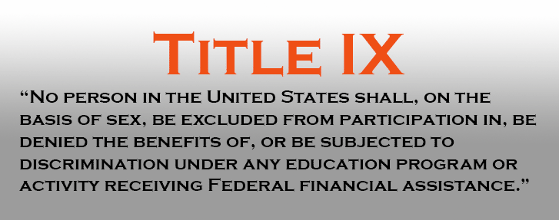
Background: What is Title IX/VAWA?
Notes:
Review Prework

Slide 8
Background: What is Title IX/VAWA?
What conduct fall under Title IX/VAWA?
    Sex or Gender-based harassment/discrimination
    Sexual Assault
    Stalking
    Dating Violence
    Domestic Violence
    Retaliation
    Sexual Exploitation
    Non-physcial Intimate Partner Violence
    Sex Offenses against a person under the age of 18

Slide 9
Background: What Does Title IX/VAWA require?
Respond promptly in a manner that is not deliberately indifferent
Treat complainants and respondents equitably
Offer supportive measures upon actual knowledge
Pursue investigation and adjudication in response to a formal complaint
Provide written notice upon receipt of a formal complaint
Dismiss a formal complaint if required
Recipient school responsible for gathering evidence
Provide equal opportunity for parties to present witnesses and evidence
Notes:
*not an exhaustive list

Slide 10
Background: What Does Title IX/VAWA require?
Provide evidence to parties and their advisors to review
Prepare an investigative report to fairly summarize relevant evidence and send to party at least 10 days prior to hearing
Provide for a live hearing
Permit each party’s advisor to ask questions of and cross-examine the other party and witnesses
Provide advisor at no cost to conduct cross-examination, if needed
Cannot rely on any statement from a party or witness who is not subjected to cross-examination
Issue written determination
Offer both parties the right to appeal both a dismissal of a formal complaint and a determination
Notes:
*not an exhaustive list

Slide 11

Dynamics of the Title IX Grievance Process

Slide 12
Dynamics of the Title IX Grievance Process
Complainants
Shame
Unsure about what happened
Everyone knows
Isolation
Labeling Effect

Slide 13
Dynamics of the Title IX Grievance Process
Respondents
It’s all on the line
How safe is the truth? How dangerous is a lie?
Crisis of the self
Everyone knows
Shame

Slide 14
Dynamics of the Title IX Grievance Process
Witnesses
Pick a side
Shame over lack of "inaction"
Scared to get in trouble

Slide 15
Dynamics of the Title IX Grievance Process
What about…
Culture
Religion
Sexual Orientation
Gender Identity
Race
Mental Health

Slide 16

Dynamics of the Title IX Grievance Process
Sam is an 18-year-old freshman from Philadelphia, PA, attending Drexel on a scholarship (without which Sam would not be able to afford school). No one else in Sam’s family has ever been to college. Sam’s mom is so proud of Sam that every time they talk on the phone, she jokes about how all of the neighbors are tired of hearing her bragging about her future engineer and says that she “always knew” Sam would be the one to “make the family proud.”
Sam is finding college coursework to be much more difficult than at public high school and is already struggling to keep up. Sam goes to a party with friends on a Friday, drinks way more than ever before, and is sexually assaulted by a stranger.
Ashamed, scared, and unable to concentrate, Sam fails two midterm exams and is unable to submit an important project on time the following week.

Slide 17
Dynamics of the Title IX Grievance Process
You are Taylor, but instead of having experienced a sexual assault yourself, you woke up after night of drinking to find yourself in bed with another student and vaguely remember having consensual sex the night before.
You don’t remember exactly what happened, but soon start hearing rumors amongst your social group that the other student is claiming that you sexually assaulted them while they were too drunk to consent.
You are confused and embarrassed, and soon receive an e-mail from the Title IX Coordinator asking to meet in their office to discuss an incident that had been reported.

Slide 18
Dynamics of the Title IX Grievance Process
You are a 20-year-old sophomore and have received an e-mail from the College’s Title IX Coordinator stating that they believe that you “may have information relevant” to a “report of an incident that may fall under the University’s Sexual Harassment and Misconduct Policy.”
The e-mail assures you that you have not been accused of wrongdoing, but that you are welcome to be accompanied to the meeting by an “advisor of choice.”
Notes:
Let’s discuss the dynamics and impact these scenarios have on each individual involved and in their respective roles.

Slide 19

Dynamics of the Title IX Grievance Process
The Dynamics of Sexual Assault, Harassment, Dating Violence, Domestic Violence, and Stalking

Slide 20

Statistics
Sexual Misconduct is a longstanding problem on campuses nationwide
  1 in 5 women (1 in 10 by partner)
  1 in 16 men (1 in 45 by partner)
  8 out of 10 are acquaintances
  90%+ do not report
  What about Stalking? Dating/Domestic Violence?
  What about impact?
Source: Nat’l Sexual Violence Resource Center, 2015
Notes:
Talk through statistics; connect it to campus community; impact on community and individuals
Sexual Misconduct: Source-
The National Intimate Partner and Sexual Violence Survey is the primary source NSVRC relies on for sexual victimization information. NISVS was launched in 2010 by the National Center for Injury Prevention and Control (U.S. Centers for Disease Control and Prevention). NISVS is an ongoing nationally representative survey that collects data on adult men and women at the national and state level. The goals of NISVS are to collect detailed information about sexual violence, physical violence by an intimate partner, and stalking. The initial, and largest, collection of NISVS data took place in 2010.

Slide 21
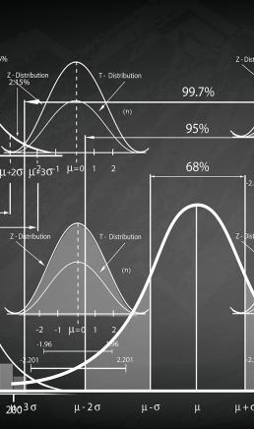
Statistics… and their limits
BEWARE…
Notes:
Be careful not to rely on these statistics to make decisions on any particular case. For instance, has anyone heard of the statistic that between 2-10% of sexual assault reports are false? That statistic doesn’t tell us everything. Don’t apply statistics to particular case.
To date, much of the research conducted on the prevalence of false allegations of sexual assaults is unreliable because of inconsistencies with definitions and methods employed to evaluate data (Archambault, n.d.). A review of research finds that the prevalence of false reporting is between 2 percent and 10 percent. The following studies support these findings: y A multi-site study of eight U.S. communities including 2,059 cases of sexual assault found a 7.1 percent rate of false reports (Lonsway, Archambault, & Lisak, 2009). y A study of 136 sexual assault cases in Boston from 1998-2007 found a 5.9 percent rate of false reports (Lisak et al., 2010). y Using qualitative and quantitative analysis, researchers studied 812 reports of sexual assault from 2000-2003 and found a 2.1 percent rate of false reports (Heenan & Murray 2006). Many published reports do not clearly define false allegation, and often include data that falls outside of most accepted definitions (Lisak et al., 2010). The International Association of Chiefs of Police (IACP) upholds that, “The determination that a report of sexual assault is false can be made only if the evidence establishes that no crime was committed or attempted” (IACP National Law Enforcement Policy Center, 2005, pp. 12-13)
https://www.nsvrc.org/sites/default/files/Publications_NSVRC_Overview_False-Reporting.pdf

Slide 22

Neurobiology of Trauma
(and limitations)
What is Trauma?
  Deeply disturbing or distressing experience
  Both a psychological and physiological response
Trauma is interpreted by the body as a life-threatening experience.
Notes:
What is Neurobiology? Simply stated, neurobiology is the biological study of the nervous system. It is a multidisciplinary field that draws upon scientific disciplines including anatomy, physiology, molecular biology, mathematical modeling, and psychology. Neurobiology helps to explain human experience, thinking, emotions, memories, and behavior in terms of brain structures and processes.
It is also helpful to recognize that stress and trauma cover a continuum, with mild stress at one end and traumatic stress at the other. For ethical reasons, scientists cannot (and do not want to) traumatize people in research experiments. So, there will never be studies of what is happening in the brains of people while they are being sexually assaulted. But we do not need such studies to understand a great deal about what happens in people’s brains during stressful or traumatic assaults or events.
When we understand the neurobiological basics of how people commonly respond while being sexually assaulted, and how stress and trauma can alter their memory processes, we reap many valuable benefits. These include more realistic expectations for complainant responses during a sexual assault, more perceptive listening to their account of what happened, and more effective information-gathering about their memories and responses. But this knowledge should not be used to explain or make assumptions about any particular complainant’s responses or memories; each individual is unique

Slide 23
Neurobiology of Trauma
(and limitations)
  → fight, flight, freeze
  → energy availability
  → physical pain reduction
  → emotional pain reduction
Notes:
A second benefit of understanding this science is to listen more perceptively to complainant responses. For example, if we know the different types of freezing responses people can have, then we can recognize indicators of them when complainants say things like, “Suddenly I froze,” “My mind was blank,” or “All I could think was...”

Slide 24
Neurobiology of Trauma
(and limitations)
The Effects
  Flat affect (or opposite)
  Fragmented/incomplete memory
  Confusion and difficulty remembering
  Changing or inconsistent emotions
Counter-intuitive response
Notes:
People will not necessarily be able to recall events in chronological order; if we understand that dissociation can kick in at any time, leading the person to “space out” and not notice what’s happening to their body, then we won’t be surprised by missing pieces of memory due to dissociation at any point during the sexual assault
The same is true for how we listen to people’s memories. If we know common characteristics of traumatic memories, we can recognize them in people’s accounts: vivid central details; vague, inconsistent, and missing peripheral details; and missing time sequencing of details. We’ll know to keep listening, without bias or assumptions

Slide 25
Neurobiology of Trauma
(and limitations)
Common Issues and Coping Mechanisms
  Delayed reporting
  Subsequent consensual interactions
  Ongoing contact
  Inconsistent disclosures
  Use of protection
  Drugs and alcohol
  Everything is fine… until it isn’t.
Notes:
One primary benefit of understanding this science is to avoid imposing assumptions

Slide 26
Neurobiology of Trauma
(and limitations)
Limitations
  Use knowledge of trauma responses to suspend disbelief, not as “proof” or as substitute for sufficient evidence
  Recognize possible effects on accused, as well
    Trauma of allegation
    Trauma of IPV? Stalking? Harassment?
    Ongoing stress impacting memory?
    Effects on demeanor/affect
Notes:
there is a risk if people take unwarranted leaps from such general understanding to specific assumptions about any particular person’s responses to alleged conduct or their memories of what happened during the experience. Instead, we must keep our minds open and engage in careful listening. And again, we must ask open-ended, non-leading questions to gather more information and fill in the entire picture, which will often have unique, new, or surprising aspects. These techniques allow us to avoid imposing assumptions, old or new, on survivors.
keep our minds open and engage in careful listening. Ask open-ended, non-leading questions to gather more information and fill in the entire picture

Slide 27
Dynamics of the Title IX Grievance Process
Investigations and Investigative Reports

Slide 28
Investigations– Process
Report
Initial Assessment by University/Title IX Coordinator
Supportive Measures
Alternative Resolution or Investigation & Adjudication
Formal Complaint
Preliminary Inquiry
Investigation
Conduct/Adjudication (If possible violation is revealed)
Remedies & Sanctions and Appeals
Notes:
Reminder of prework

Slide 29
Investigations– Purpose & Scope
Fact Gathering vs. Fact Finding
Investigator as info coordinator
  Asks all the questions
    Complainant, Respondent, Witnesses
  Identifies all the evidence
    Physical, electronic, documentary
    Examples: Medical records; text messages; social media; pictures

Slide 30
Investigations– Purpose & Scope
Investigative Reports & Investigator as scribe
  Documents procedural steps as well as substantive info
  Some gatekeeping function, but not overly restrictive
  As comprehensive as possible
    Closes important loops
    Notes evidence obtained and not obtained (and why)
  Reviewed by parties for comment and feedback
Notes:
Under the new regulations, parties review all information that is directly related, even if it is not relevant. It is likely that the parties will therefore be reviewing information that ultimately doesn’t make it into the final version of the investigative report that you all, as board members, review. We will discuss that further later in this presentation.

Slide 31
Preparing for and Conducting Hearings

Slide 32
Goals of the CB Process
Provide a fair and transparent mechanism for assessing complaints and determining responsibility for alleged misconduct
Ensuring that all parties have a fair opportunity to provide and respond to information
Process- not punitive
  Minimize “transaction costs” to all parties
Last line of defense.

Slide 33
Preparing to Adjudicate
Beware of conflicts
Check your bias
Identify and anticipate issues
  Scrutinize investigative materials
  What is there, what isn’t there (and why)?
  What else do I need to know?
  Evidentiary issues
    Completeness (medical records, text convos, etc.)
    Equitable access
    Weight
Notes:
Be honest with yourself, each other, and us. We would much rather you identify a conflict or potential conflict or appearance of a conflict as soon as possible, than on the back end.

Slide 34
Preparing to Adjudicate
Reviewing investigation reports
  Give yourself time
  Think critically – channel your inner skeptic
  First read, second read
  Create timelines, charts, grids, and lists
  Scrutinize attachments/exhibits
  Refer to policy elements
  Need for follow-up or additional steps?
Respondent is presumed not-responsible

Slide 35
Preparing for and Conducting Hearings
Hearing Practices and Procedures

Slide 36
Hearing Practices- Serving Impartially
Be objective
Be professional
You don’t have to be an expert
Be an active listener
Don’t look for a winner
  Your job is not to make everybody happy
  Your job is to make a commonsense evaluation of credibility/responsibility

Slide 37
Hearing Practices- Serving Impartially
Set aside personal biases and prejudices
  Beware of assumptions about how someone would/should behave
  Don’t project morals
Mind your demeanor
Mind your emotions
Be polite and respectful to parties, witnesses, and advisors (even if they don’t reciprocate)
Maintain appropriate sensitivity
You represent the University and the process

Slide 38
Hearing Practices
Use the tools you already have
  Respect and decency
  Fundamental knowledge of human behavior
  Common sense, sound judgment
  Understanding of campus setting and context

Slide 39
Hearing Procedures
A hearing will generally proceed as follows:
Introductions of all attendees
Overview of investigation by Investigator
Questions posed to Investigator by Advisors and Adjudicator/Conduct Board
Brief introductory remarks from the Complainant
Brief introductory remarks from the Respondent
Questions posed to Complainant by Respondent’s Advisor and Adjudicator/Conduct Board
Questions posed to Respondent by Complainant’s Advisor and Adjudicator/Conduct Board
Questions posed to Complainant’s Witnesses by Respondent’s Advisor and Adjudicator/Conduct Board
Questions posed to Respondent’s Witnesses by Complainant’s Advisor and Adjudicator/Conduct Board
Short recess
Brief concluding remarks by Complainant
Brief concluding remarks by Respondent
Notes:
Live participation by parties who can hear and see one another, with real-time, oral questioning; Live hearings may be conducted with all parties physically present in the same geographic location or, at the recipient’s discretion, any or all parties, witnesses, and other participants may appear at the live hearing virtually, with technology enabling participants simultaneously to see and hear each other.

Slide 40
Preparing for and Conducting Hearings
Evidentiary Issues During Hearings

Slide 41
Evidentiary Issues During Hearings
  Types of evidence
  Investigative report (primary)
  Testimonial (live)
  Documentary evidence
    Texts, e-mails, social media
    Medical records
  Physical evidence
  Direct vs. circumstantial evidence
  What about “hearsay?”
Notes:
Rules do not speak to admissibility of hearsay, prior bad acts, character evidence, polygraph results, or similar issues; rather, they require the recipient school to gather and evaluate relevant evidence
Hearsay- discuss weight of that evidence, reliability, credibility

Slide 42
Evidentiary Issues During Hearings
  Relevance and perspectives
  Privileged information and records
  Prior sexual history (rape shield)
  Prior or subsequent misconduct
  "Directly related" evidence
  "Character" evidence
Notes:
we will address each of these specifically in the next slides…

Slide 43
Evidentiary Issues During Hearings- Relevance
"Relevant" evidence/questions - any questions and evidence that tend to make an allegation of sexual harassment or misconduct more or less likely to be true.
Relevant evidence includes both inculpatory and exculpatory evidence.
Relevant evidence may NOT include:
  Privileged information and records
  Prior sexual history
Notes:
Examples of relevant and irrelevant evidence

Slide 44
Evidentiary Issues During Hearings- Privileged Information
Information protected under a legally recognized privilege cannot be sought, obtained, submitted, relied upon, or asked about unless:
    the person holding the privilege waives the privilege with voluntary, written consent
Examples:
  Medical records or information
  Mental health records or information
  Attorney-client privileged communication and documents

Slide 45
Evidentiary Issues During Hearings- Sexual History
Evidence and questions about the Complainant’s sexual predisposition or prior sexual behavior are not permitted unless:
  They are offered to prove that someone other than the Respondent committed the conduct alleged by the Complainant, or
  They concern specific incidents of the Complainant’s prior sexual behavior with respect to the Respondent and are offered to prove consent.
Notes:
Possible example of when prior sexual behavior may be permitted to prove someone other than the respondent committed the conduct alleged:
Allegations of sexual assault by a stranger; evidence of another man’s semen would go to identity of the alleged perpetrator therefore would go to a respondent’s position that it is mistaken identity
Complainant and Respondent were in a dating relationship during which time they engaged in sexual intercourse that included occasions of consensual strangulation. Respondent brings in prior sexual behavior with the Complainant to show how consent was provided previously and why they believed this encounter was consensual as well.

Slide 46
Evidentiary Issues During Hearings- Prior or Subsequent Misconduct
Evidence of a pattern of inappropriate behavior by a Respondent is permissible so long as it is judged for relevance like any other evidence
Prior or subsequent conduct may be relevant to demonstrate:
    Intent, knowledge, or state of mind
    Motive
    Opportunity
    Lack of mistake
    Pattern
    Identity

Slide 47
Evidentiary Issues During Hearings- Directly Related
“Directly related” evidence may be broader than “relevant” evidence
  Therefore some evidence may be redacted in the investigative report or documents
Directly Related
Directly Related
and Relevant

Slide 48
Evidentiary Issues During Hearings- Character
Cannot exclude Character evidence
Presumption of non-responsibility

Slide 49
Evidentiary Issues During Hearings
  Expect the unexpected
  What about new information?
  Contested Evidence
  Try to address in advance
  Can you unring the bell?

Slide 50
Evidentiary Issues During Hearings
  What if we’re stuck?
  The Board has discretion
  Start with policy for answers and guidance
  Ask questions to understand positions/challenges
  Take a break!
  Do you have to decide?
  Use your best judgment, rooted in policy and fairness
  Explain rationale and preserve issue
  Reference in rationale, if needed

Slide 51
Preparing for and Conducting Hearings
Questioning During Hearings

Slide 52
Questioning During Hearings
  Evaluating and posing questions to/from
  the parties
  Parties’ chance/right to pose questions
  Review question for relevance & appropriateness
  Build in pause
    Allow time between question being asked and answer given to allow Conduct Board to review question, determine if it is relevant and appropriately worded, and/or should be reworded or not answered at all.
  What about redundancy?
  What about re-phrasing?
Notes:
Presenters demonstrate what this looks like in practice re: question being asked, pause, conduct board decides if the question is relevant and appropriately asked, conduct board instructs party or witness to either answer or not answer, etc.

Slide 53
Questioning During Hearings-
Cross Examination
Conducted by each Party’s Advisor
May ask other Party and witnesses relevant questions
Must be conducted directly, orally, and in real time by Advisor
  NEVER by a Party personally
Adjudicator/Conduct Board must first determine whether question is relevant and if it not, explain why it is being excluded as irrelevant
Notes:
May consult with Title IX Coordinator or designee about this

Slide 54
Questioning During Hearings-
Cross Examination
If a party or witness does not submit to cross-examination at the live hearing, you may not rely on any prior statement, either written or oral, of that Party or witness in reaching a Determination
  Conduct Board will be instructed to disregard and not consider any statements made by someone who does not submit to cross-examination at live hearing
A Party’s Advisor may still conduct cross-examination even if the Party to whom they are advising does not appear
Notes:
Explain what this looks like in practice if a party or witness was interviewed in the investigative report, that report was reviewed by both parties and their advisors as well as the Conduct Board, their presence was requested for the hearing, and they do not appear and/or do not submit to cross-examination.
Tips: It will be helpful for the board members to have a full hard copy of the Investigative Report (normally this would be provided for in-person hearings; in a remote setting this may be more difficult to ensure?); identifying and/or crossing out whoever’s testimony cannot be considered may be helpful during deliberations (1) as a reminder to not consider the testimony, and (2) to help each other keep track of what information can be considered and from where the information came (ie: if a board member found a certain piece of evidence or testimony compelling and is relying on that in making a factual determination, all board members can check the investigative report and their notes from the hearing to confirm where the information came from and that it is not solely from a witness whose testimony can no longer be considered)

Slide 55
Scenario
The case before the conduct board involves allegations of sexual assault where the complainant testifies that she was unable to consent due to incapacitated from alcohol consumption.
Complainant and Witness live together in the same house. In the investigative report, Witness said in her statement that she saw the Complainant and Respondent come home together after a night of drinking at a bar in University City. Witness stated that the Complainant’s clothes were disheveled, her speech was slurred, and she saw the Complainant fall up the stairs as the Complainant and Respondent proceeded to Complainant’s bedroom.
Witness’s presence was requested at the hearing, but she did not appear. Witness did not submit to cross-examination.
What happens to Witness’s testimony in the Investigative Report?
What can you, the Conduct Board, consider from this witness?
What can’t you consider?

Slide 56
Scenario
The case before the conduct board involves allegations of Dating Violence- physical assault. Both the Complainant and Respondent were interviewed by the Investigator and their statements appear in the Investigative Report. Their presence is requested at the Conduct Board hearing. Complainant does not appear and does not submit to cross-examination. Respondent appears and submits to cross-examination by the Complainant’s Advisor.
What happens to Complainant’s statement in the Investigative Report?
What happens to the Respondent’s statement in the Investigative Report and testimony from the live hearing?
Why does the Complainant’s Advisor still question the Respondent if the Complainant is not present at the hearing?
Does your answer change if it was the Respondent who did not appear and submit to cross-examination?

Slide 57

Questioning During Hearings
  Question with Purpose
  Hear it for yourself (and from the source)
  Clarify and confirm
  Identify issues, Close loops
  Flesh out new info

Slide 58
Questioning Technique –
Manner Matters!
  Consider tone, style, and volume
  Take time to “soften the ground”
  Listen well and actively
  Avoid conveying judgment (via phrasing or tone)
  Let there be silence
  Project Respect and Support
  Non-verbal cues
  Mirroring/Checking/Reflecting
  Explain process and questions
Notes:
What do we mean by “soften the ground?” Why is this important? Can anyone provide an example of how that might look?

Slide 59
Questioning Techniques
  Open-ended – Free recall, narrative
  Focused – Directs attention
  Multiple Choice – Range of options, but room for flexibility
  Yes/No – Clarify/confirm discrete issue
  Leading – Assumes the answer
Notes:
Provide examples of each for Board to hear.
Example:
To help demonstrate these types of questions using a simple, yet relatable, topic… let’s try to figure out if Paul cuts his peanut butter sandwiches on a diagonal.
Open ended: “Paul, can you tell me about everything you ate yesterday?” or “Paul, can you walk me through what you ate for lunch yesterday?”
Focused: “Paul, I’d like to talk to you about the peanut butter and jelly sandwich you ate for lunch yesterday…”
Multiple Choice: “Paul, did you cut your sandwich length-wise, on a diagonal, not cut at all, or something else?”
Yes/No: “Paul, did you cut your sandwich diagonally, yes or no?”
Leading: “Paul, you cut your PB&J sandwich on a diagonal, right?”
Can we try this out using OED-3 topics?

Slide 60
“Hard Questions”
  Be sensitive… but not avoidant
  Be fair in identifying
  How to ask
  Acknowledge the elephant
  Ask permission
  Be thoughtful in phrasing – choose right tool for the job
  Give time and space

Slide 61
Questioning Techniques – Phrasing
  Can you tell me about…
  What happened next?
  What did you/he/she/they do when…
  Can you tell me what you mean by…
  Can you help me understand…
  How did…
  … is that correct?

Slide 62
Questioning Techniques – Phrasing
  DO NOT ASK:
  Are you asking us to believe…?
  So you’re taking antidepressants and had an exam in the morning, but instead of staying home to study you decided to go out drinking?
  That doesn’t make sense.
  So while you were assaulting him/her/them…
  (To Complainant) I’m so sorry to have to ask this, but…
  (To Respondent) So while you were [alleged act], did you [action]?

Slide 63
Decision Making and Outcomes

Slide 64

Assessing Credibility
Evaluations of responsibility often turn on questions of credibility
  Consent (including withdrawn consent)
  Wanted/unwanted
  Incapacitation
  Intimate Partner Violence
Credibility can be assessed based on a variety of factors, including:
  Demeanor
  Interest
  Detail
  Corroboration
  Common-Sense

Slide 65
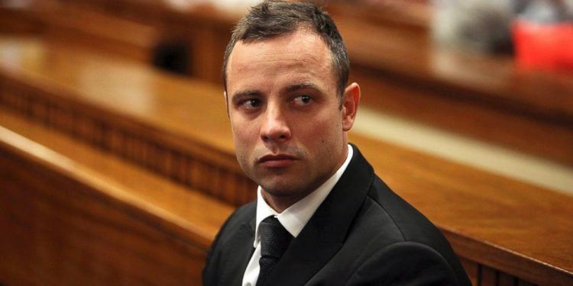
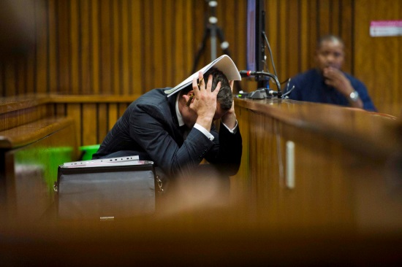
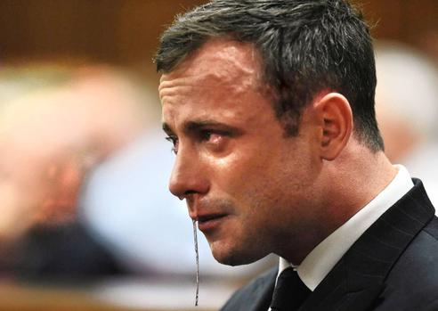
Assessing Credibility - Demeanor
During/after events underlying case
  Sources of info
    Outcry/Responding witnesses
    Law enforcement/medical providers
    Family/friends
  Indicators
    Withdrawn?
    Distracted?
    Depressed?
    Angry?
    No observed changes?
During Hearing

Slide 66
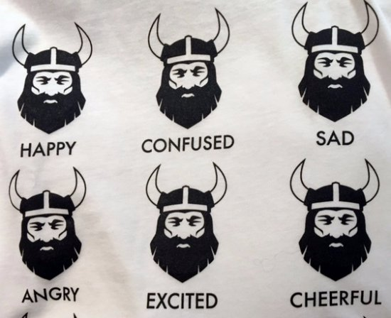
Demeanor Evidence – Beware!
Be careful about assumptions re: how someone would/should behave
Reactions may vary
  Complainant
  Respondent
  Witnesses
Examples: Laughter, smiling, flat affect, hostility
If concerned, look for reasons why!

Slide 67

Assessing Credibility– Bias/Interest
Do the parties have a prior relationship?
  What does that look like? (good and bad, pattern of consent, etc.)
Does a witness have “skin in the game?”
  Examples: Part of same club as one of the parties, used to date one of the parties, may be ostracized by friend group
Are other factors influencing participation?
  Examples: fear, anxiety, time, money, culture, etc.
… But does it “fit?”

Slide 68

Assessing Credibility- Detail
Provides a high level of detail (including ancillary details)?
  “Good lies” = 95%, but the truth = 100%
Acknowledges “bad facts”? Declines potentially “good facts”?
Sensory memory?
Free recall?
“Ring of Truth”

Slide 69

Assessing Credibility- Corroboration
Cross-reference accounts of parties and witnesses, as well as other evidence
  Where are the gaps? Where is there agreement?
Use your report notes and outline/chart of issues
“Zoom out” as needed
Don’t be afraid of unresolved questions – but note them
Look for “tells” (identify key divergences)

Slide 70

Assessing Credibility – Common Sense
Inherent plausibility and the “smell test”
“If x, then…”
What hangs together?
  Consider the stories you’ve been told and what you know about the parties, situation, etc.

Slide 71
Assessing Credibility and Evidence–
Special Issues
Consent, Withdrawn Consent, and Prior Relationships
Trauma, Incapacitation, Alcohol, and Drugs
  Absence of evidence ≠ equal evidence of its absence (necessarily)
Intimate Partner Violence
Mind the “Benefit of the Doubt”
  Evidence
  Credibility Assessments

Slide 72
Decision Making and Outcomes
Deliberations and Outcomes

Slide 73

Deliberation Techniques –
Fundamentals
Be respectful and egalitarian amongst Board members
Listen and be receptive to others’ perspectives
Never mind statistics – Ground your discussion in facts, policy, and burden of proof
Evaluate, don’t advocate

Slide 74

Deliberation Techniques - Process
Discuss ground rules and manner of deliberation (e.g., “secret ballot,” discuss and vote, etc.) at outset
Identify charges at issue and vote separately on each
Read/review relevant policy definitions before voting
Separate consideration of responsibility from sanctioning

Slide 75

Deliberation Techniques – Process
Use your notes, grids, and timelines
Identify areas of agreement, isolate conflicts for discussion
Facts (and policy), not feelings (or judgment)
Even if you agree, discuss why
Seek out – but do not demand – consensus
  Remember – burden is on Complainant/University
  Majority vote

Slide 76

Burden of Proof
Preponderance of the evidence
  “More likely than not”
  “50% plus a feather”
  “Tipping the scale”
Can be met, or defeated, based upon quality of evidence, not just quantity
  Word-against-word
  Direct vs. indirect
  Hearsay
Stick to it – not beyond a reasonable doubt
Presumption of non-responsibility

Slide 77

Deliberations and Outcomes-
Written Rationales
Written Rationale – communicate your decision and the reasons therefore
  List charged offenses
  Summarize determinative facts/evidence
  Match facts to policy elements and burden of proof
  Don’t be afraid to note opposing facts
  Reference outstanding issues
  Tell us why you didn’t decide X…?
Goal – You were fair and deliberative. Show us how.

Slide 78
Deliberations and Outcomes –
Determination
Both Parties will be simultaneously notified of the Determination in writing

Slide 79
Deliberations and Outcomes –
Remedies & Sanctions
In cases involving the use of a single Adjudicator, the Senior Executive Director for Student Conduct (or designee), in consultation with the Title IX Coordinator and Adjudicator, will determine appropriate Remedies and Sanctions.
In cases involving the use of a Conduct Board, the Board will recommend Remedies and Sanctions to the Senior Executive Director for Student Conduct (or designee), who will determine appropriate Remedies and Sanctions in consultation with the Title IX Coordinator.
Both Parties will receive simultaneous written notice of the Remedies and Sanctions within ten (10) days of the Parties receiving notice of the Determination.

Slide 80
Deliberations and Outcomes –
Remedies & Sanctions
In determining appropriate Remedies and Sanctions, the Adjudicator shall consider the following factors:
the nature and violence of the conduct at issue;
the impact of the conduct on the Complainant or other appropriate Parties;
the impact or implications of the conduct on the community or the University;
prior misconduct by the Respondent, including the Respondent’s relevant prior discipline history, both at the University or elsewhere (if known), including criminal convictions;
whether the Respondent has accepted responsibility for the conduct;
maintenance of a safe and respectful environment conducive to learning;
protection of the University community; and,
any other mitigating, aggravating, or compelling circumstances in order to reach a just and appropriate resolution in each case.
Notes:
Applicable for both student and employee respondents

Slide 81
Deliberations and Outcomes –
Remedies & Sanctions (Students)
Sanctions include the following:
Expulsion
Withdrawal of (rescind) degree
Withholding of a degree
Suspension Loss of Privileges
Deferred Suspension
Loss of housing
Deferred loss of housing
Ban from university housing/ban from residence halls
Housing reassignment
Restricted access
Disciplinary probation
Assignment of a constructive/ educational task
Hold on record
Restitution
Disciplinary reprimand
Notes:
Applicable for students

Slide 82
Deliberations and Outcomes –
Remedies & Sanctions (Employees)
Disciplinary measures that may be imposed under this policy include:
Warning
Educational Requirement
Formal Performance Improvement Plan
Restitution
Suspension
Termination
Notes:
Applicable for employees (not specifically relevant for this Conduct Board training but keeping it in for completeness and if/when HR boards or outside adjudicators are provided this training for review)

Slide 83
Deliberations and Outcomes –
Appeals
Right to appeal
  Either party may appeal
  Limited grounds:
At the discretion of the Title IX Coordinator, or their designee, an appeal may be assigned to either an Appellate Adjudicator or an Appeal Board (collectively, the “Appellate Authority”)

Slide 84
Deliberations and Outcomes –
Appeals
Grounds for Appeal:
Unduly harsh sanction: To determine whether the sanction(s) imposed was appropriate for the violation of OED-3 of which the student was found in violation.
Improper procedure: To determine whether the original adjudication process was conducted fairly in light of the charges and information presented, and in conformity with prescribed procedures.
New evidence that has become available that was not reasonably available at the time of the hearing: To consider new information sufficient to alter a decision or other relevant facts not brought out in the original adjudication process, because such information and/or facts were not known or reasonably available to the person appealing at the time of the original hearing.
Conflict of interest or bias: To determine whether the Title IX Coordinator, the Investigator(s), or the decision maker(s) had a conflict of interest or bias for or against the student that affected the outcome of the matter.

Slide 85

Before we close…
Questions?

